Slide 1
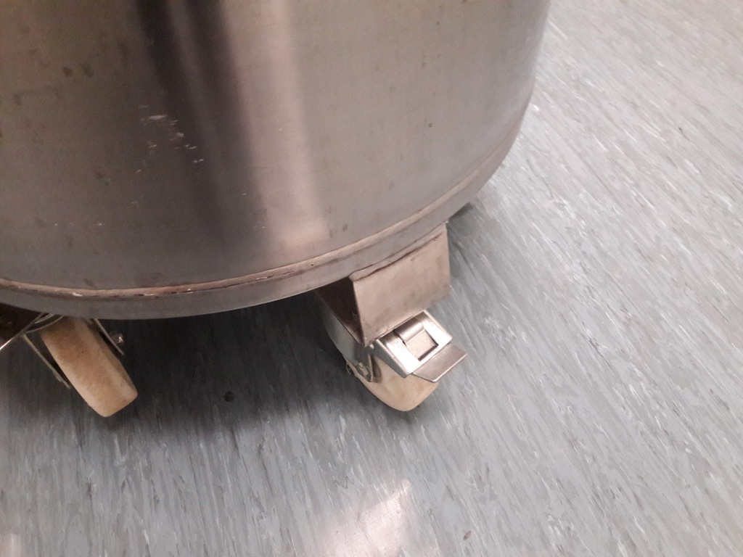
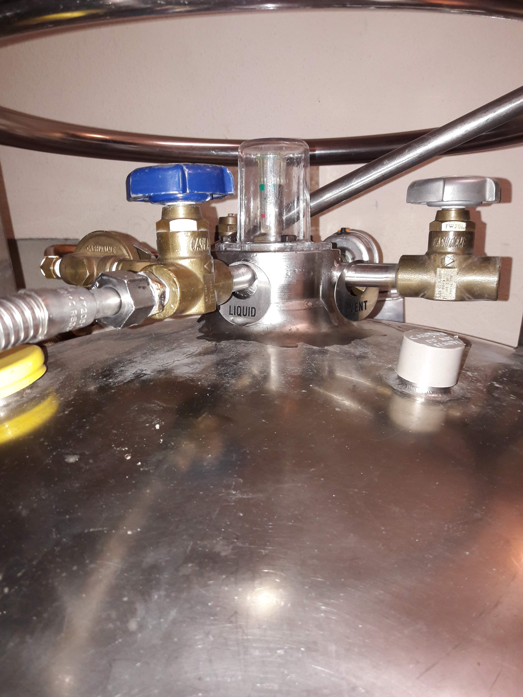
EZRC - LN₂ containers in Bldg. 341
2 mobile storage tanks are parked next to side entrance
Refilled weekly by delivery service
4 sample containers should be refilled twice weekly as shown below
Open this door to move
Check brake is not set
Check that tube is attached to “LIQUID” outlet
Only operate blue valve

Slide 2
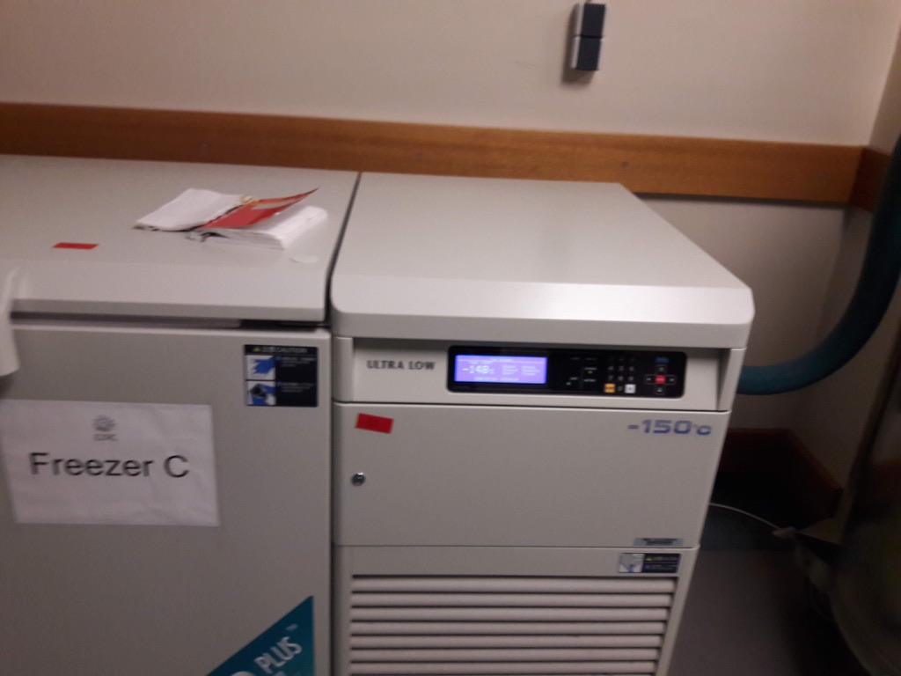
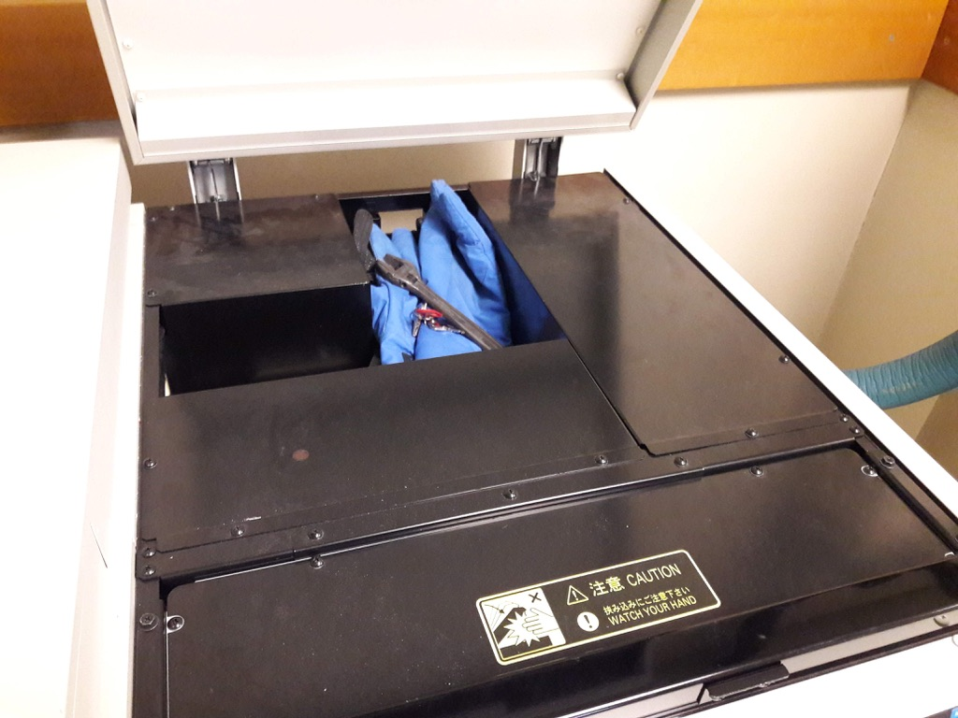
EZRC - LN₂ containers in Bldg. 341 hallway
Keys and gloves and (if needed) wrenches are in a “secret” compartment in the cryogenic freezer
Pull lever above display to open

Slide 3
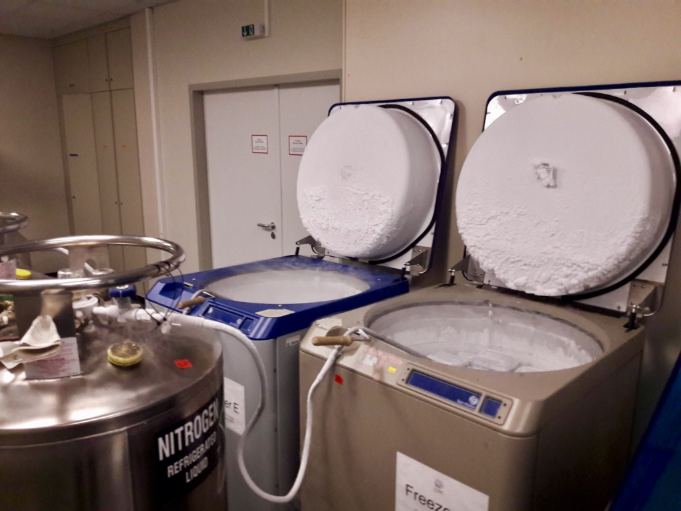
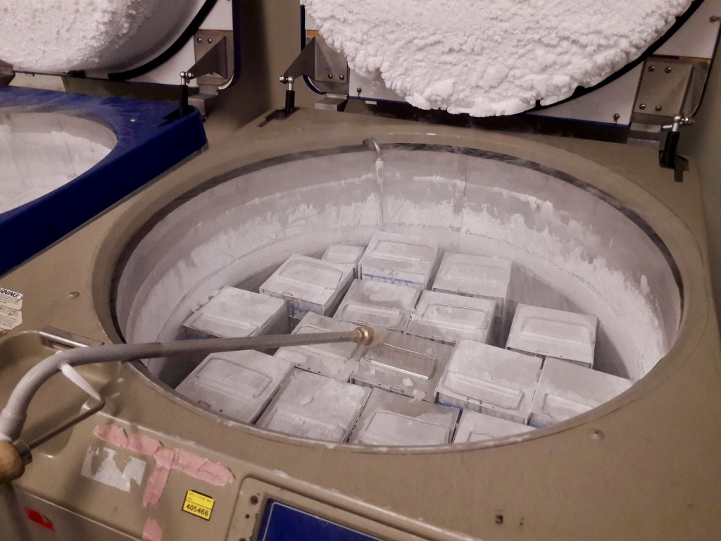
EZRC - LN₂ containers in Bldg. 341 hallway
Fill square containers until towers incl. handles are just covered

Slide 4
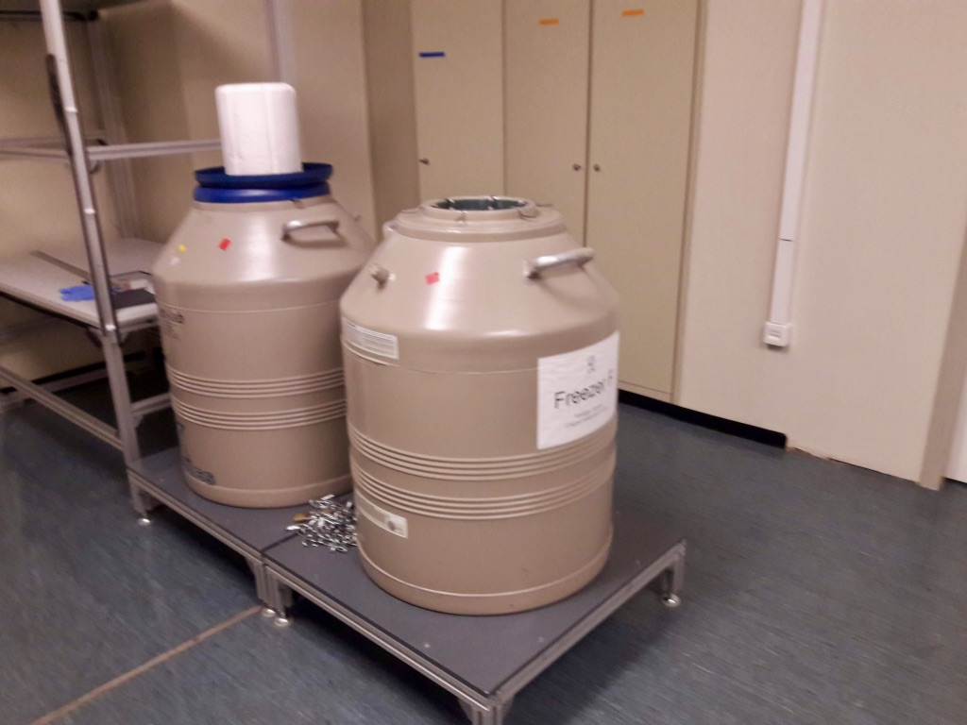
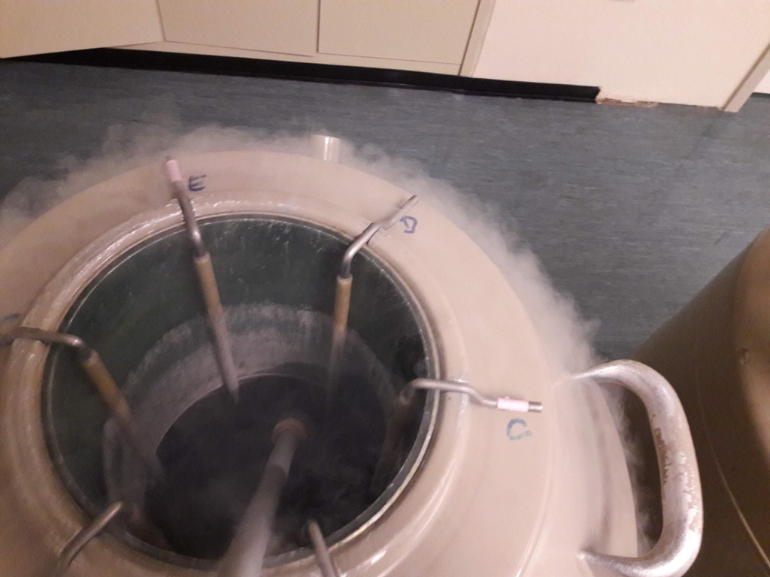
EZRC - LN₂ containers in Bldg. 341 hallway
One key opens both round containers
Fill until liquid just reaches the neck
Max. liquid level

Slide 5
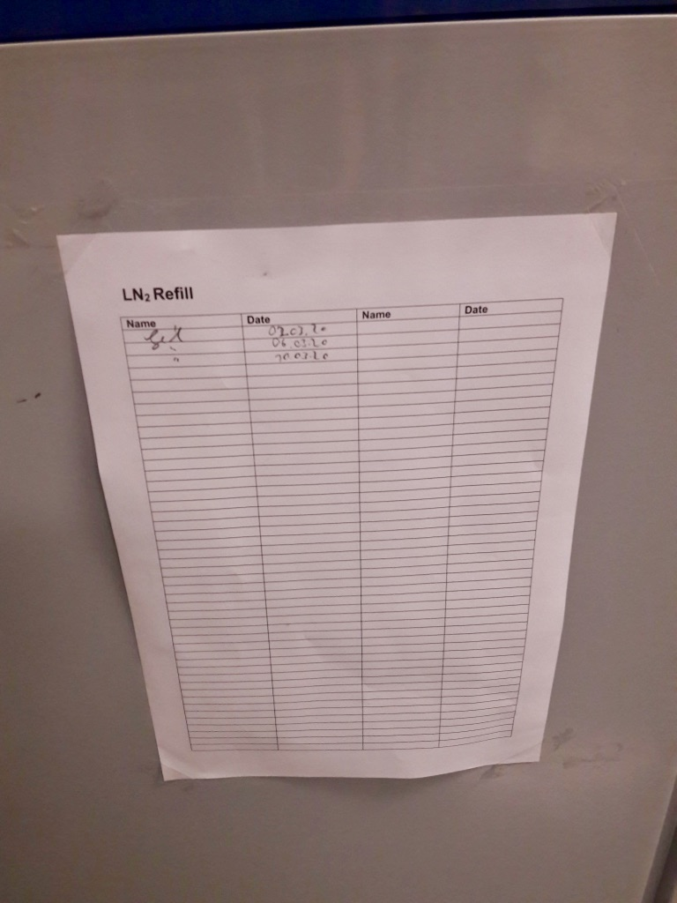
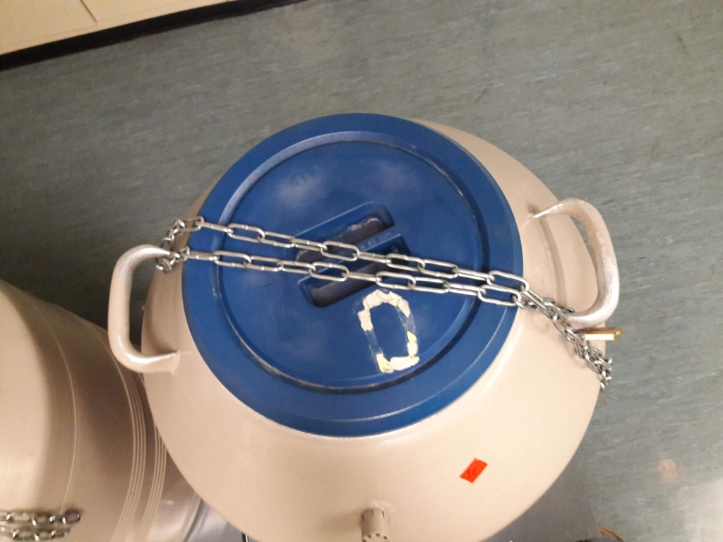
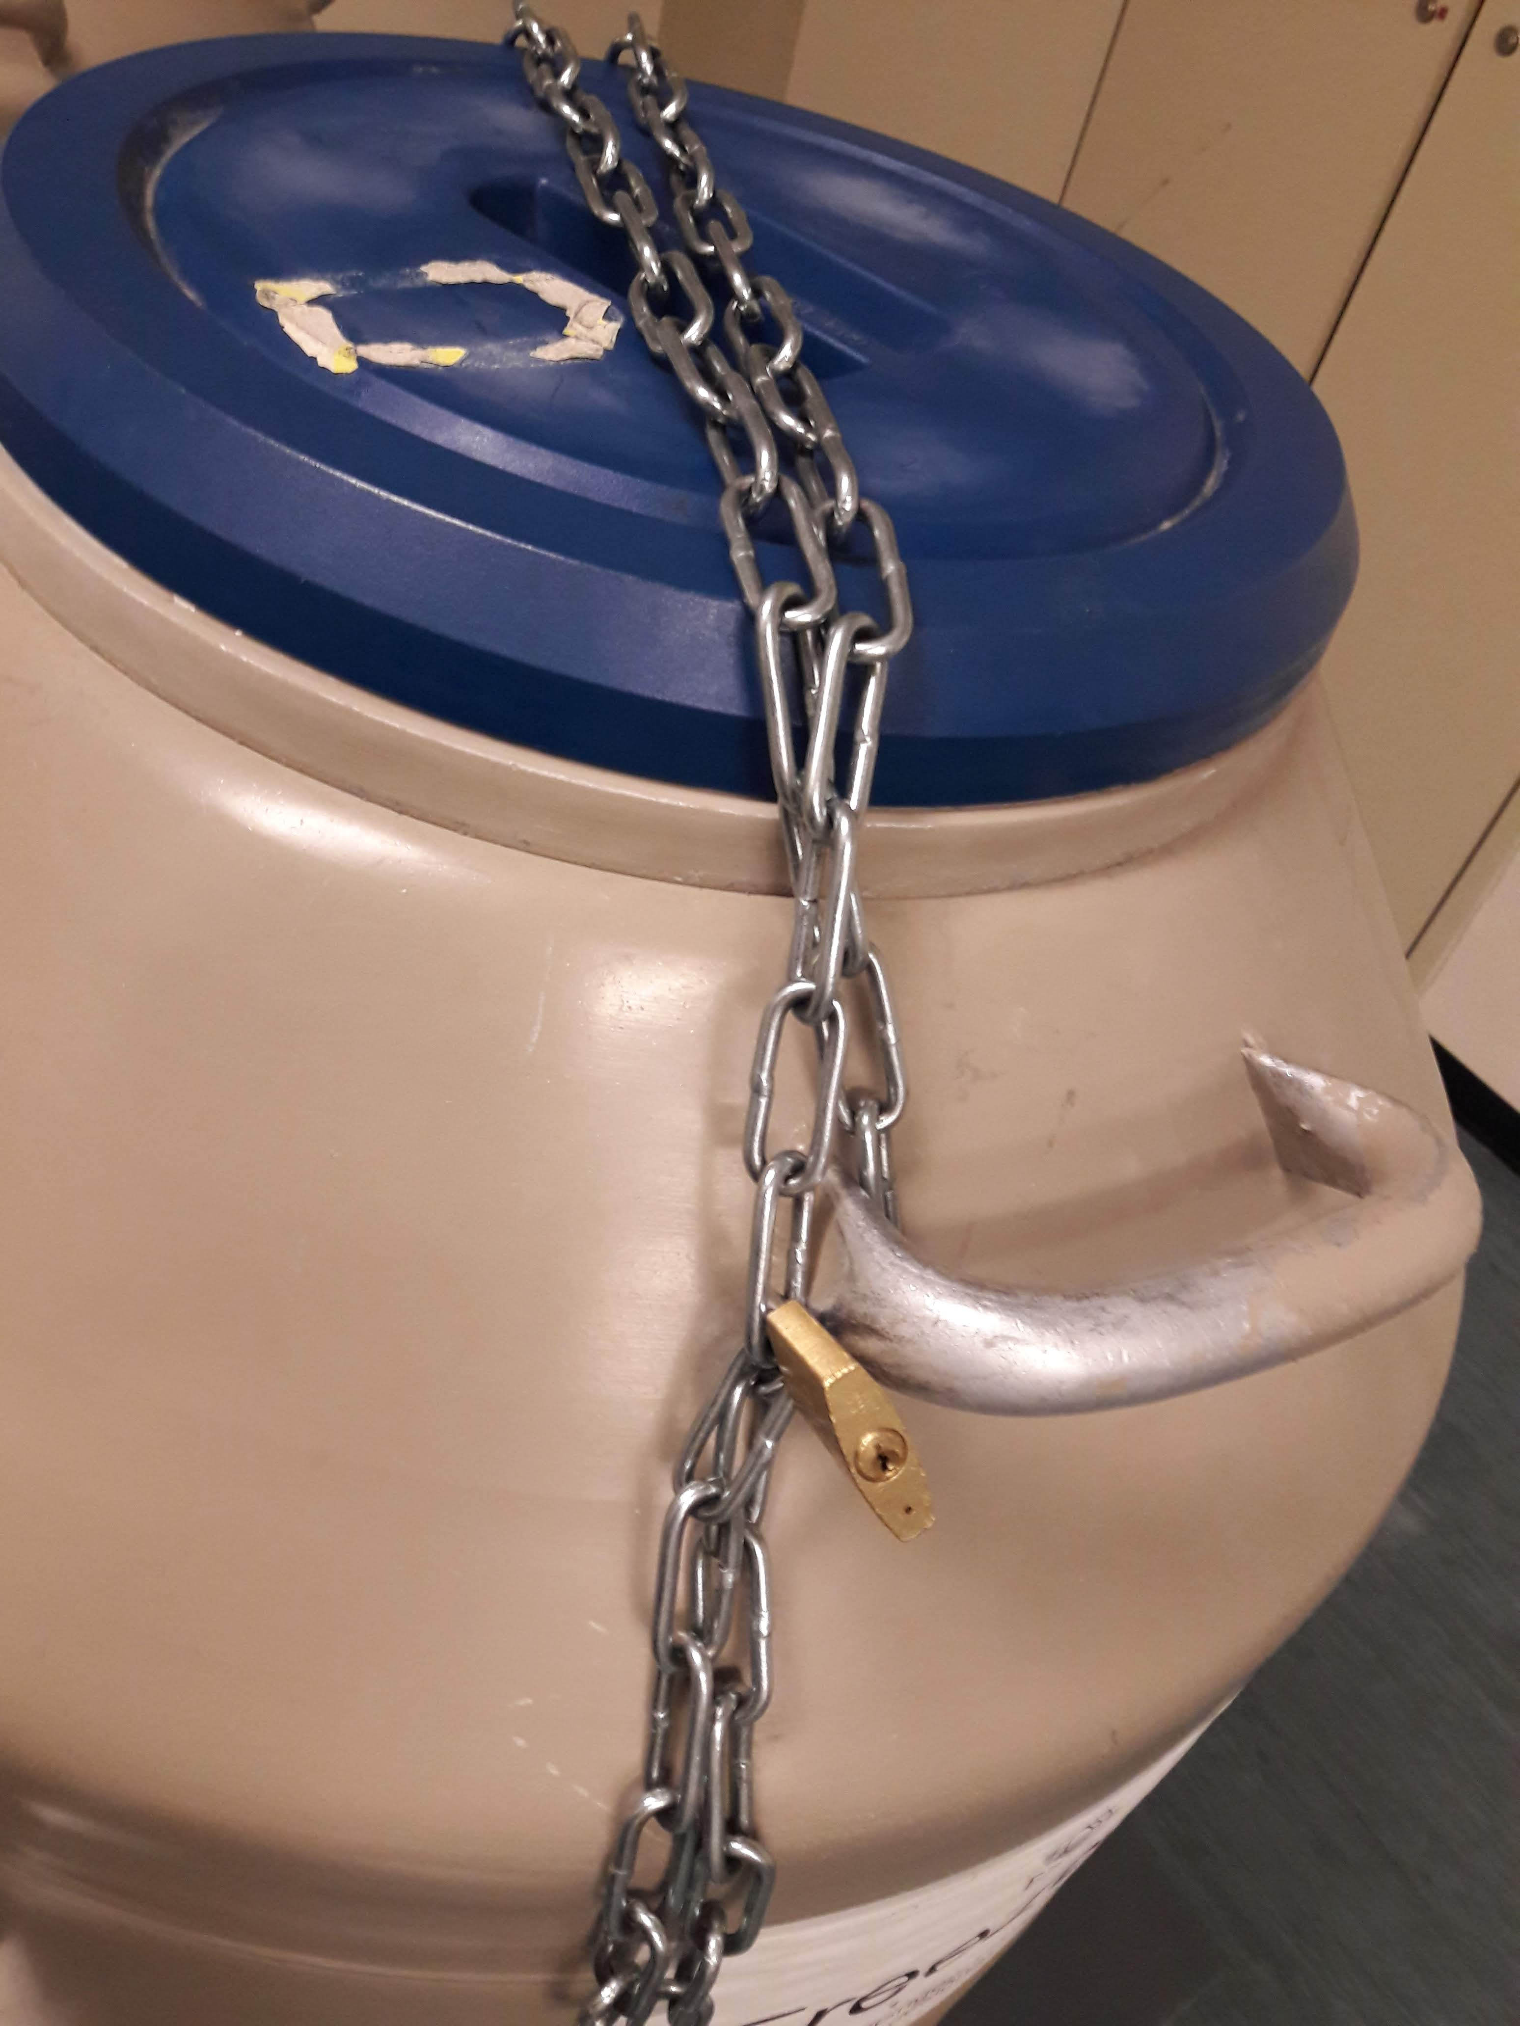
EZRC - LN₂ containers in Bldg. 341 hallway
Lock like this
Sign list

Slide 6
EZRC – cryogenic freezer in Bldg. 341 hallway
Emergency LN₂ tank is refilled and reattached weekly by delivery service
Freezer is automatically flooded if temperature rises
Valve to freezer must be open at all times
In emergency keep filled with LN₂ until serviced by manufacturer
-147 to -150 °C is normal, must never exceed -130 °C

Slide 7
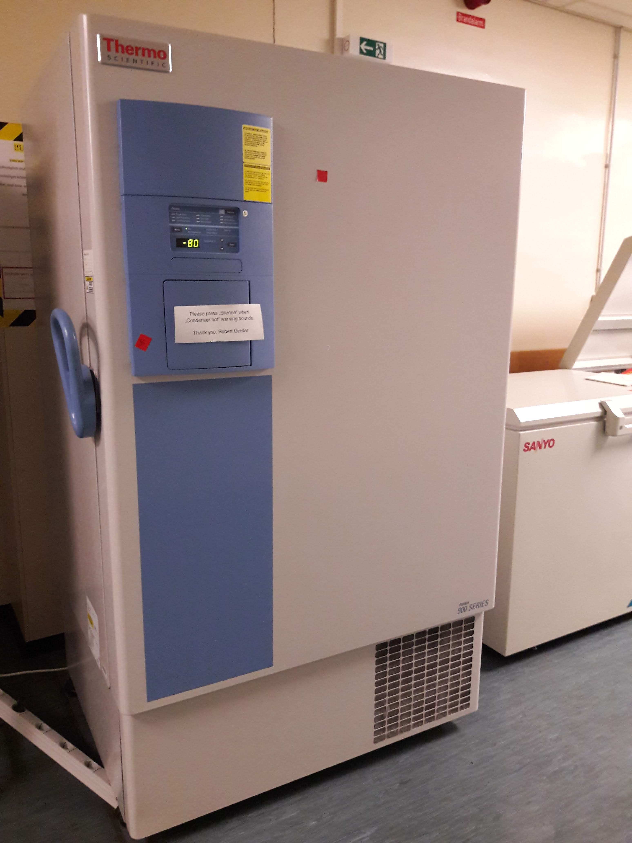
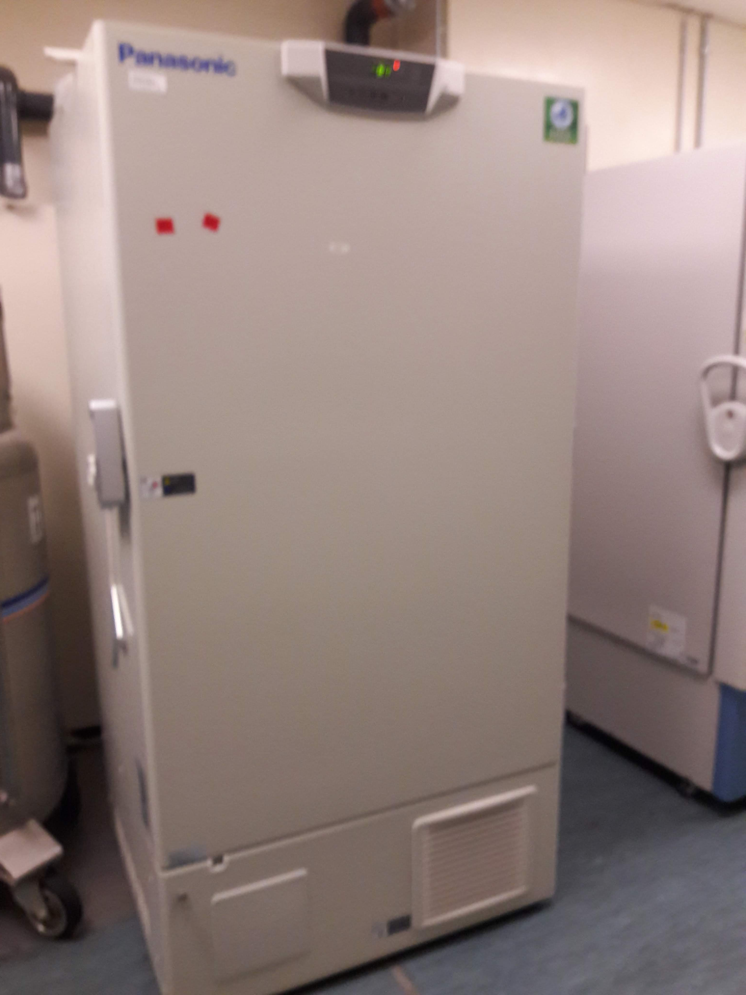
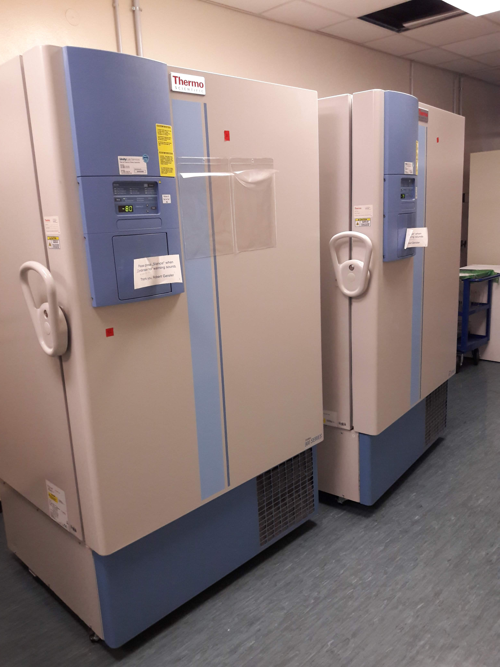
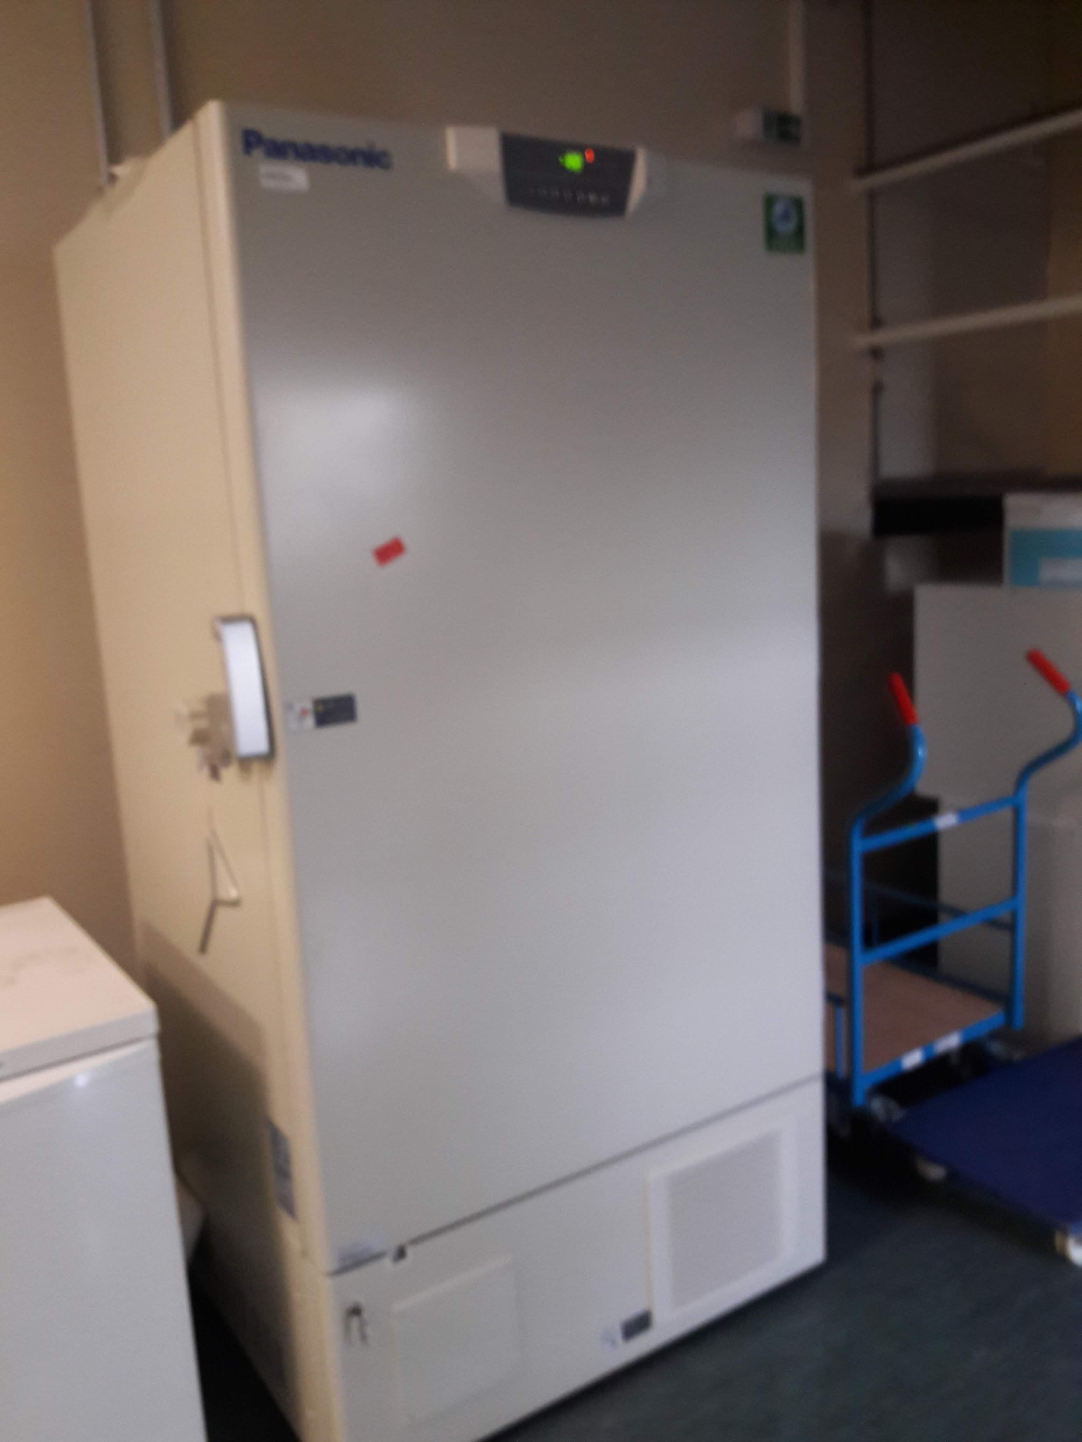
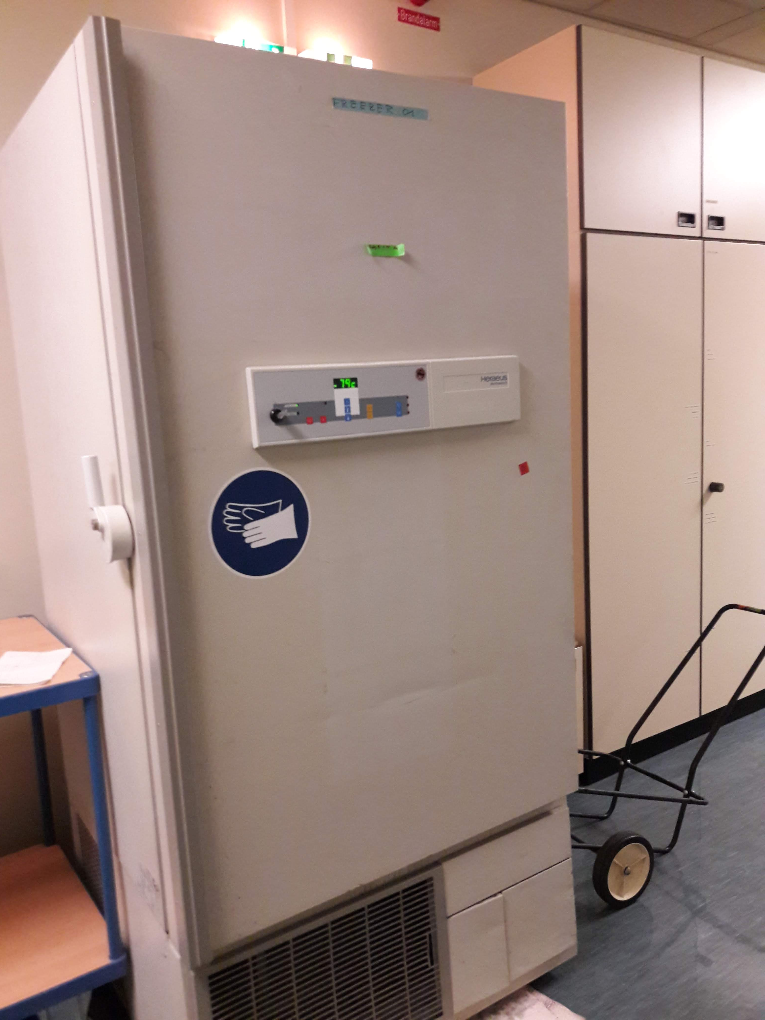
EZRC - 80 °C freezers in Bldg. 341 hallway
Contain samples from Tübingen screens, not high priority
In case of break-down empty out and discard as there is very little reserve space (garbage bags in cleaning kitchen next to side entrance)
Save boxes labelled “SC” or “FDA library”, they belong to the Screening Center
Also ”ZF PAC library”

Slide 8
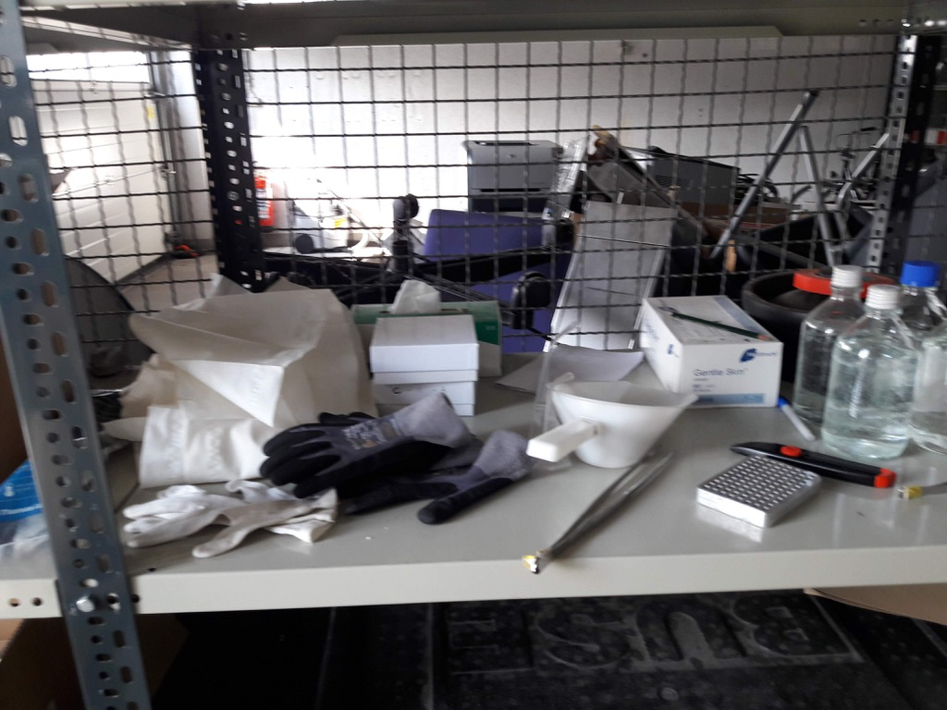
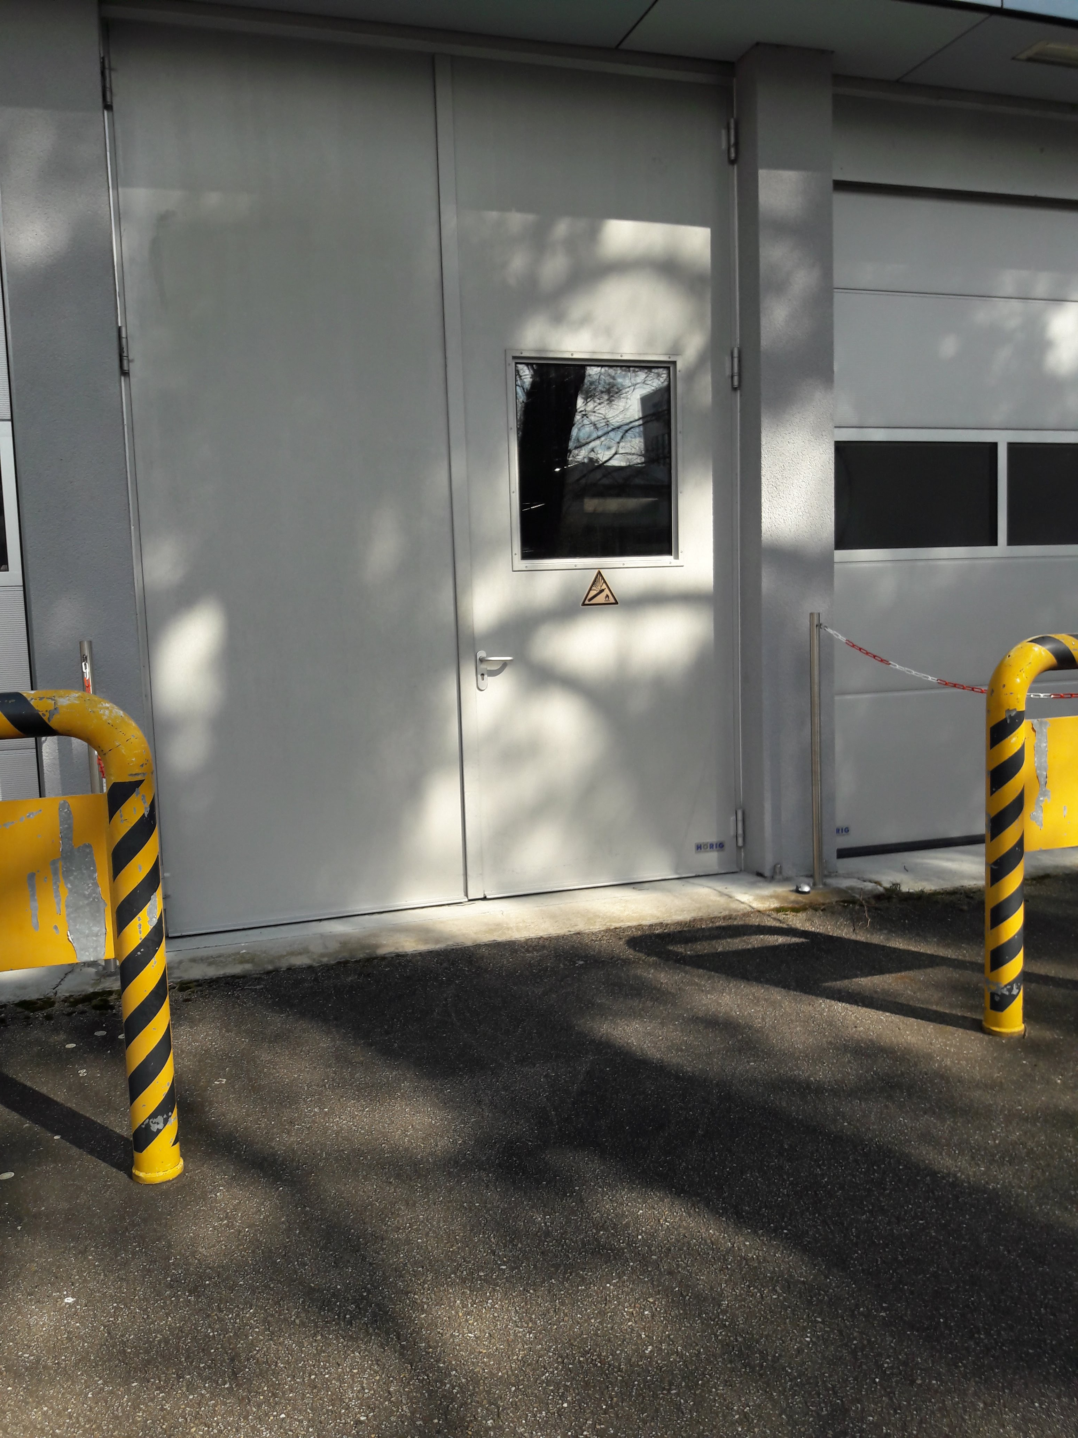
EZRC – 2 cryogenic freezers in Bldg. 223 garage
Emergency LN₂ tanks are refilled and reattached weekly by delivery service
Freezers are automatically flooded if temperature rises
In emergency keep filled with LN₂ until serviced by manufacturer
Door is open
Keys hidden here

Slide 9
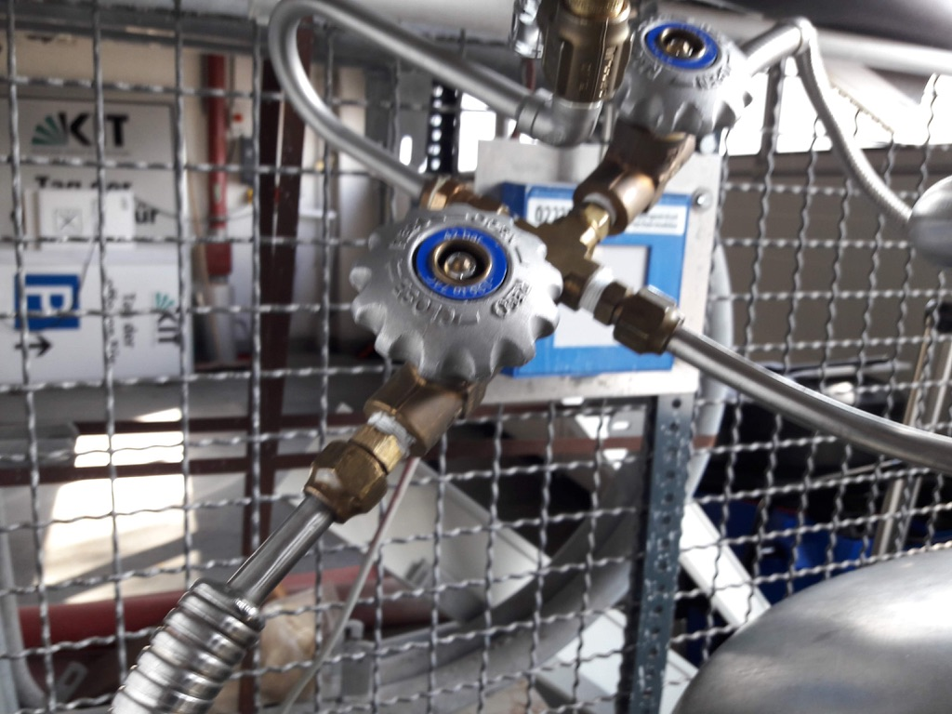
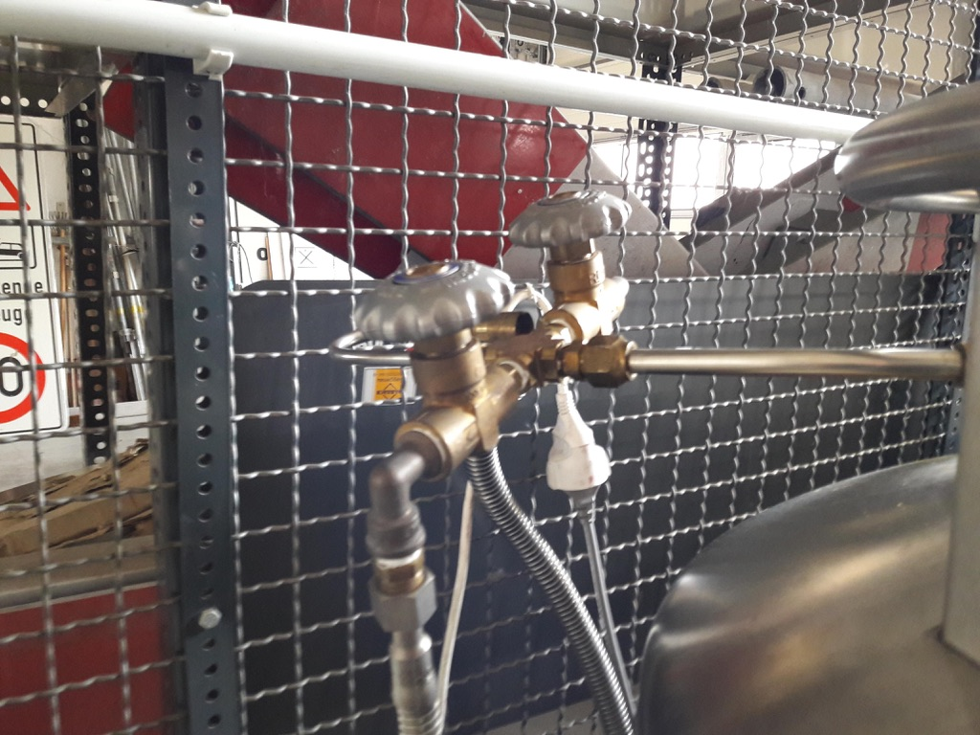
EZRC – 2 cryogenic freezers in Bldg. 223 garage
Emergency LN₂ tanks should be attached like this (normally by delivery service)
Valves to freezer must be open at all times

Slide 10
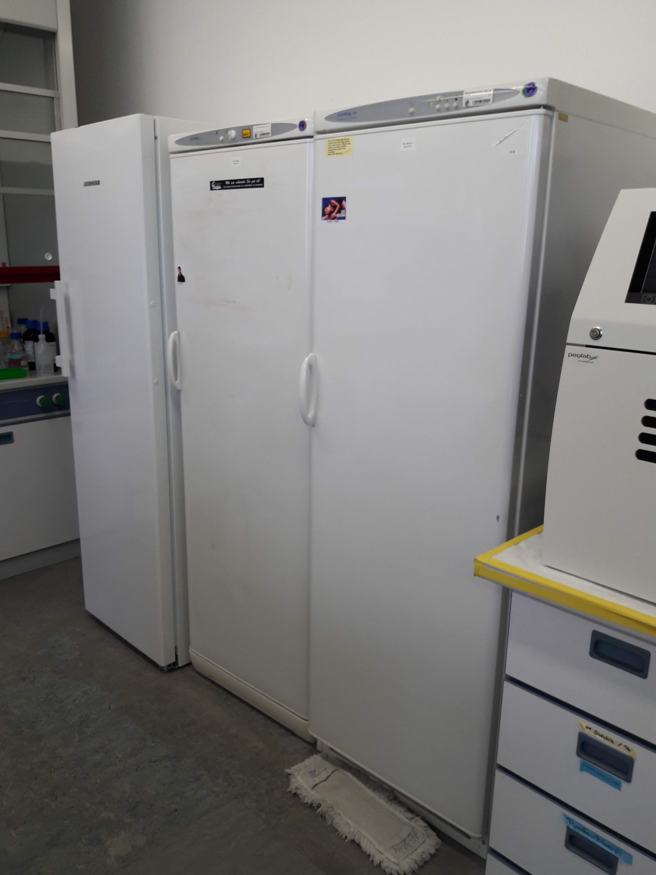
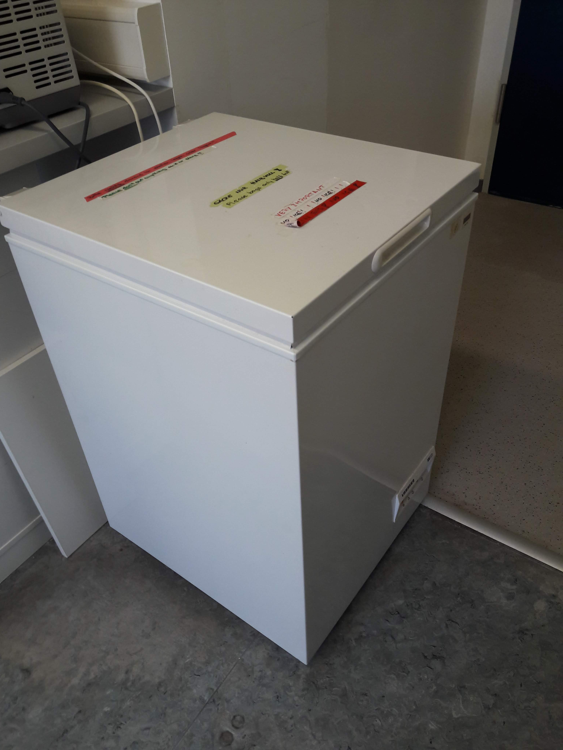
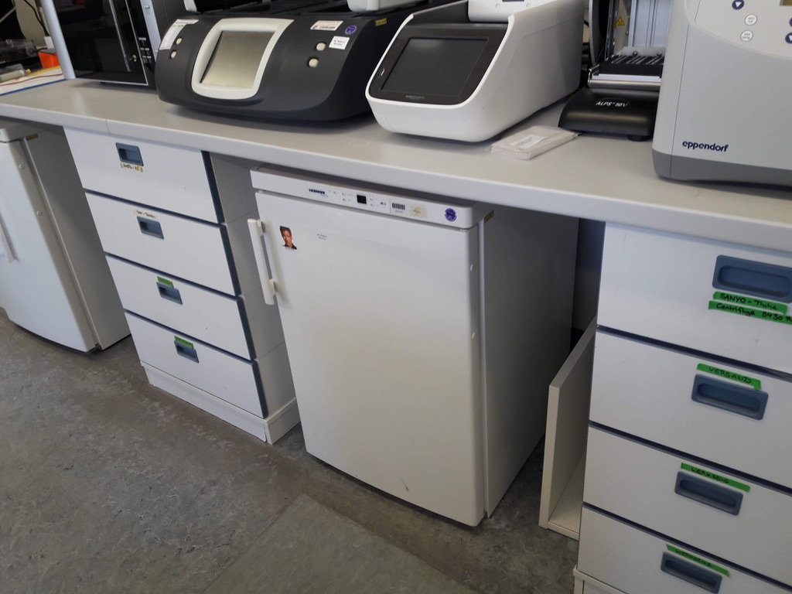
EZRC – Bldg. 223 lab
-20 °C
-20 °C reserve
-20 °C
-20 °C, some reserve space
-20 °C for dead fish
Refrigerator

Slide 11
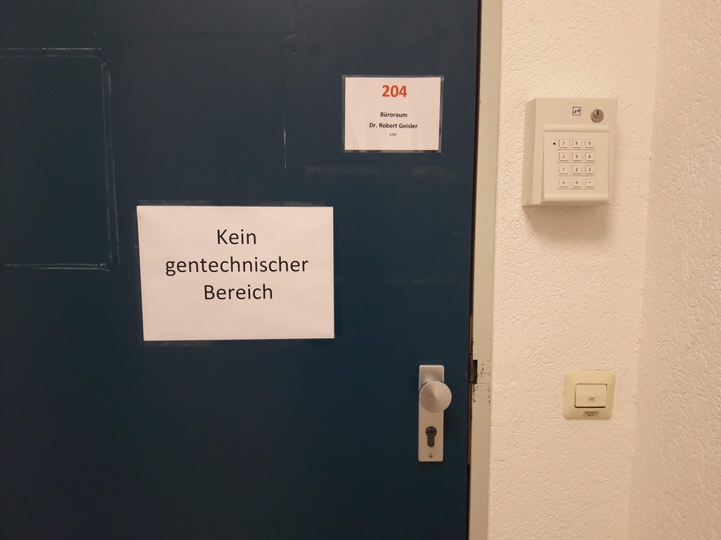
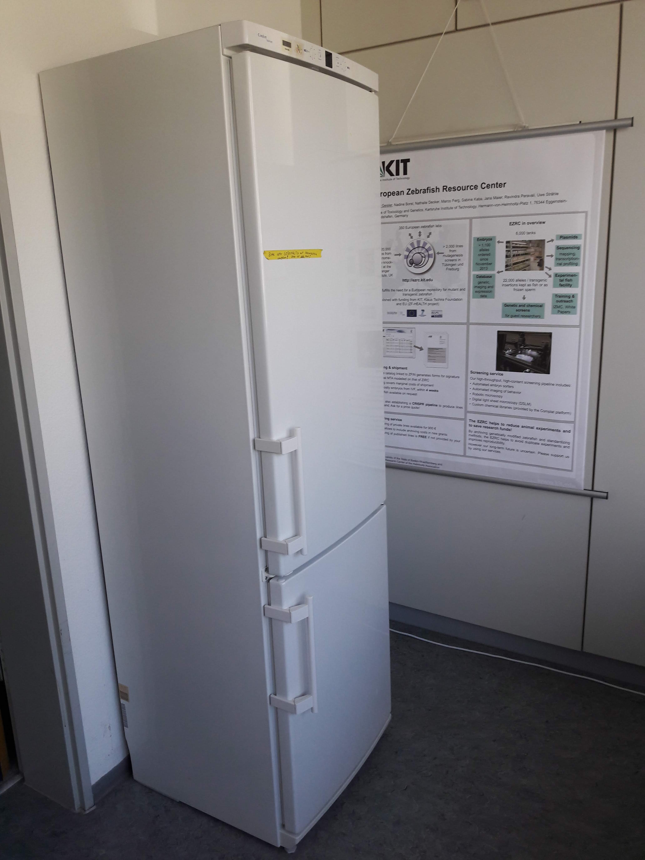
EZRC – Bldg. 223 office
code 673425
fish food refrigerator
- 20 °C, some reserve space

Slide 12
EZRC – 2 cryogenic freezers in Bldg. 223 garage
Emergency LN₂ tanks are refilled and reattached weekly by delivery service
Freezers are automatically flooded if temperature rises
In emergency keep filled with LN₂ until serviced by manufacturer
Door is open
Keys hidden here

Slide 13
EZRC – 2 cryogenic freezers in Bldg. 223 garage
Emergency LN₂ tanks should be attached like this (normally by delivery service)
Valves to freezer must be open at all times

Slide 14
EZRC – Bldg. 223 lab
-20 °C
-20 °C reserve
-20 °C
-20 °C, some reserve space
-20 °C for dead fish
Refrigerator

Slide 15
EZRC – Bldg. 223 office
code 673425
fish food refrigerator
- 20 °C, some reserve space

Slide 16
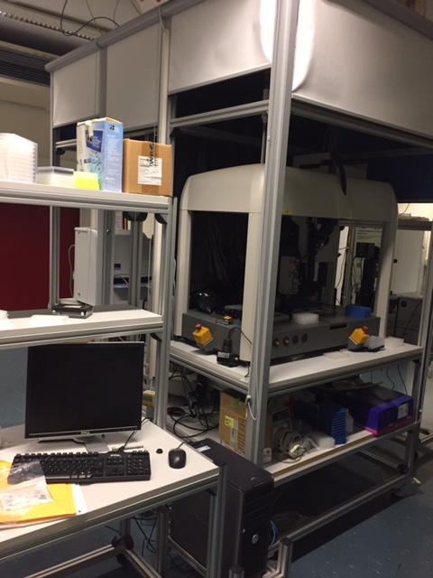
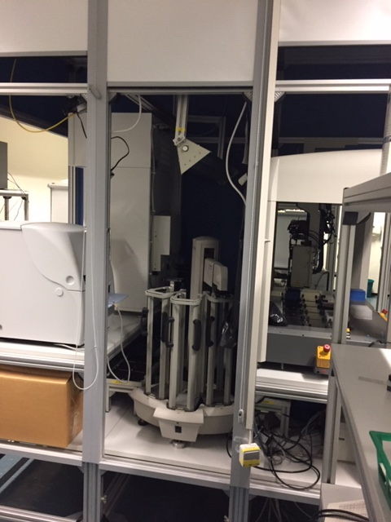
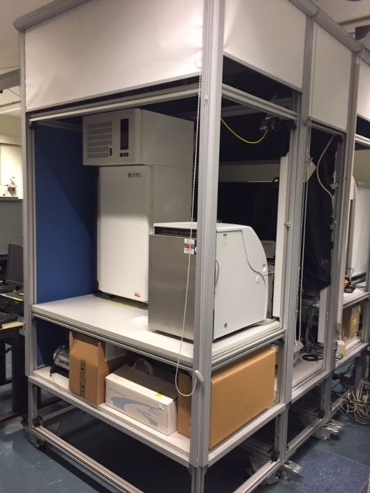
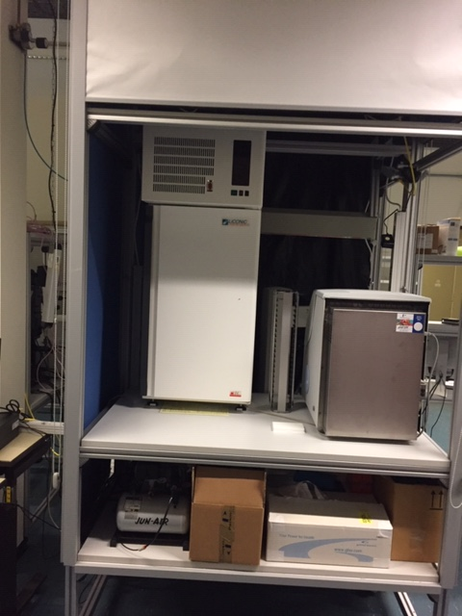
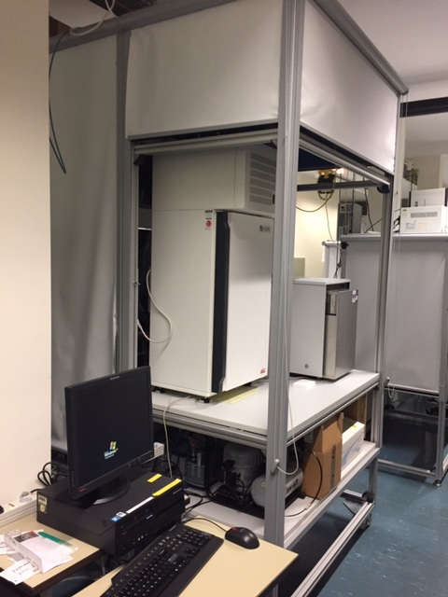
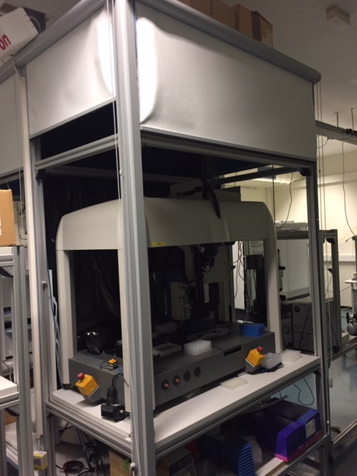
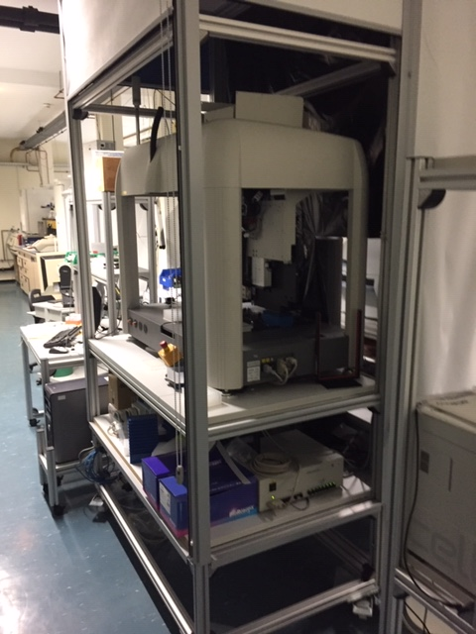
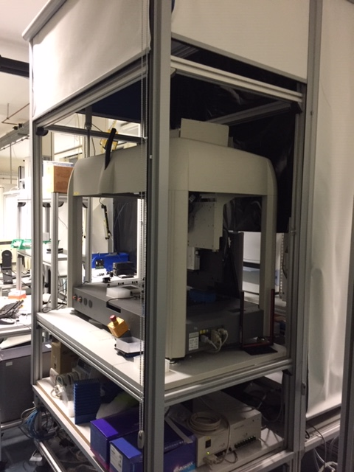
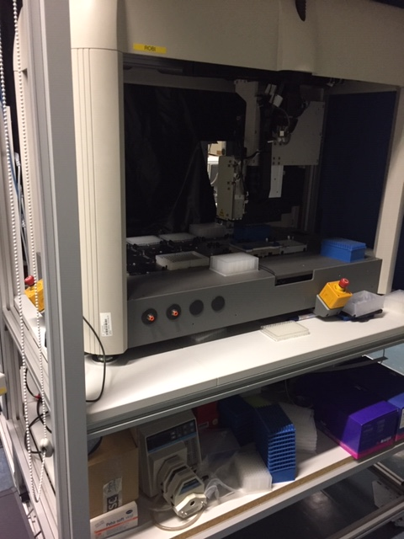
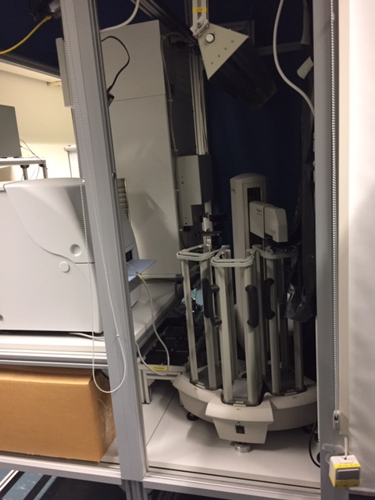
Perkin Elmer Devices 341
Not to be switched off!

Slide 17
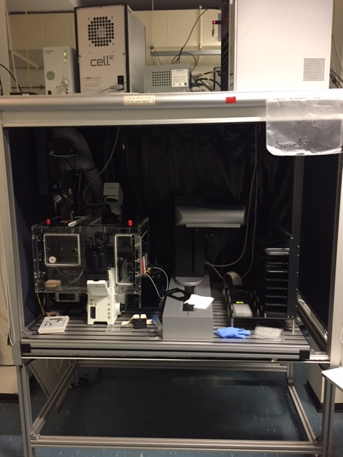
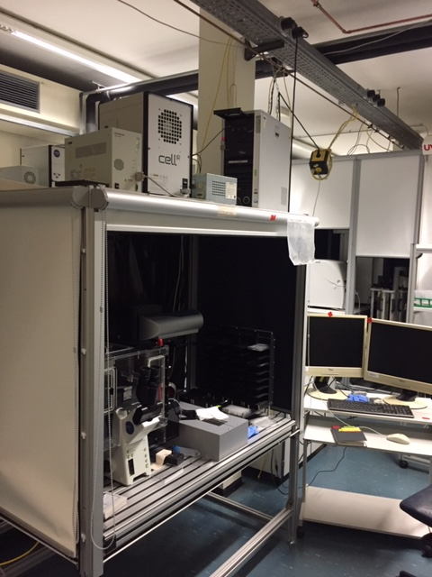
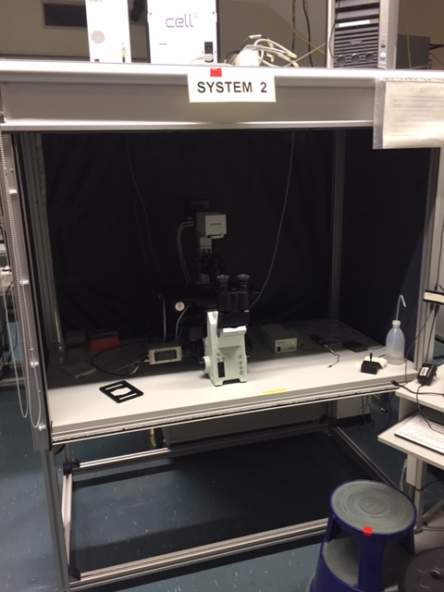
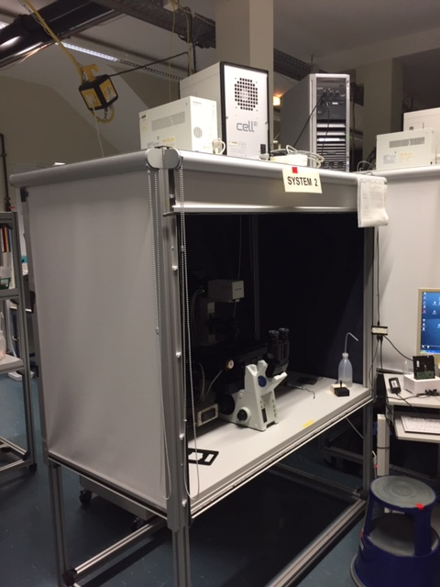
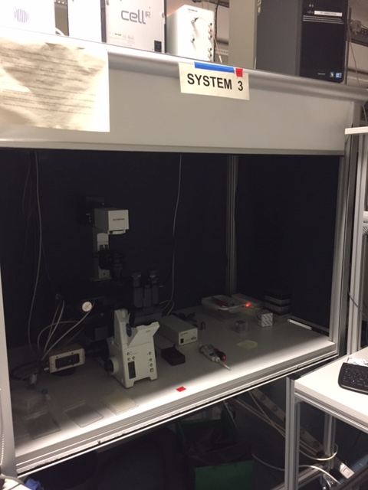
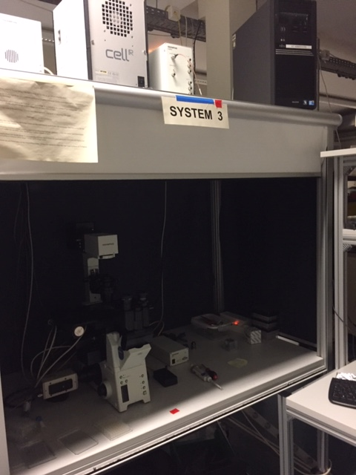
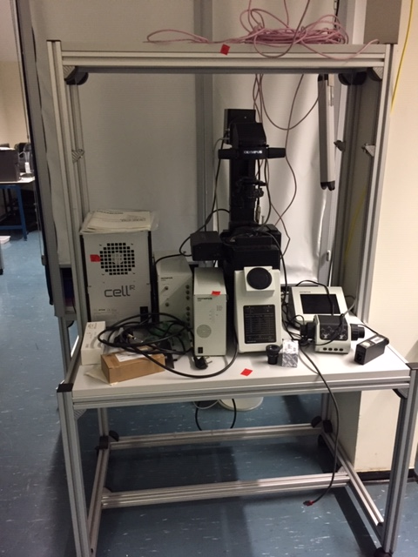
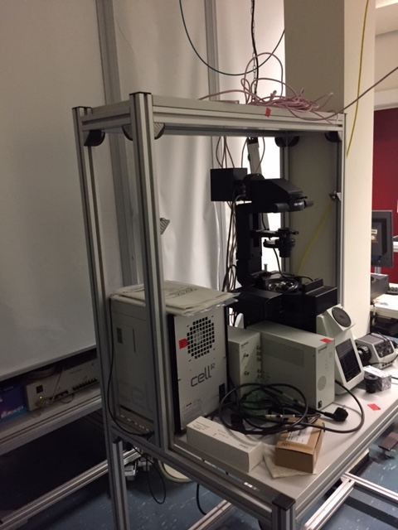
The computers are not to be switched off! The light sources should be switched off after the experiments.
Olympus Devices 341

Slide 18
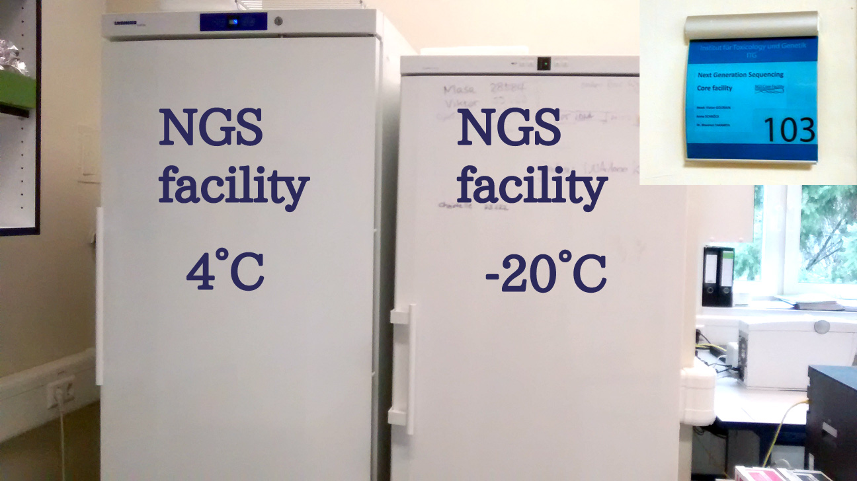
NGS 341

