Slide 1
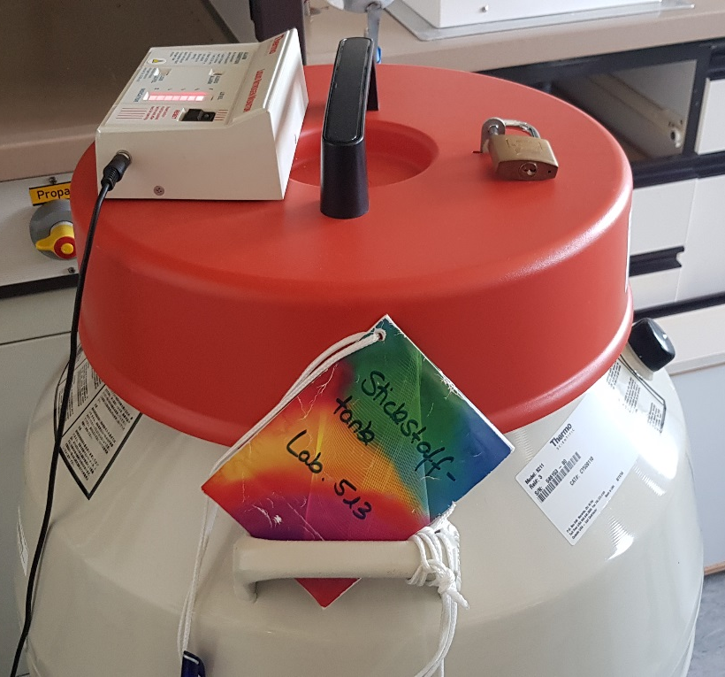
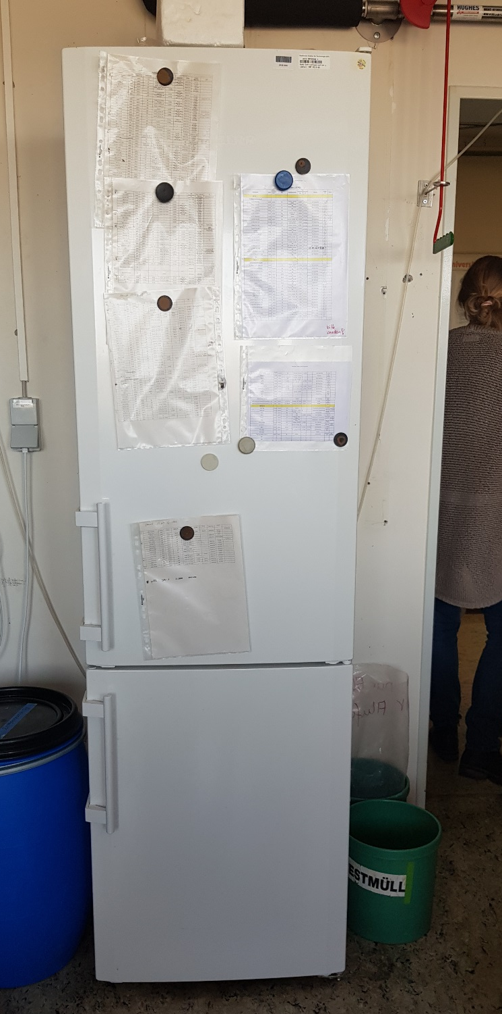
Building 439, room 513
N₂ tank: filling only by authorized colleagues, level indicator outside
combi: check temperature, in case of alarm, the content must be moved to another cooling device, e.g. in 021

Slide 2
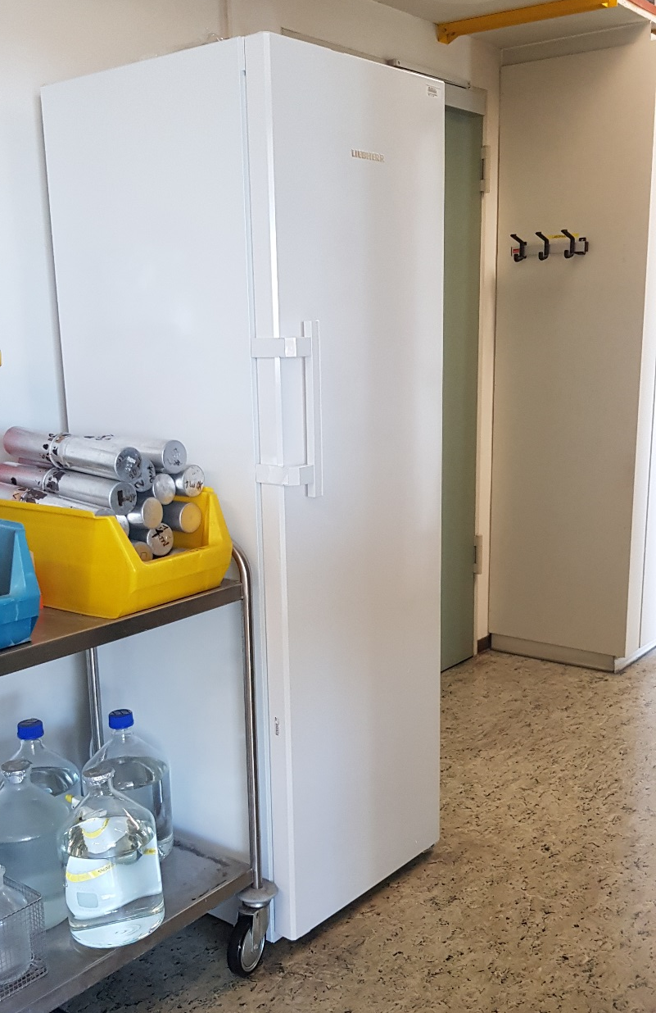
5. floor, corridor, close to room 512
-20°C freezer: check temperature, in case of alarm, the content must be moved to another cooling device, e.g. in 021

Slide 3
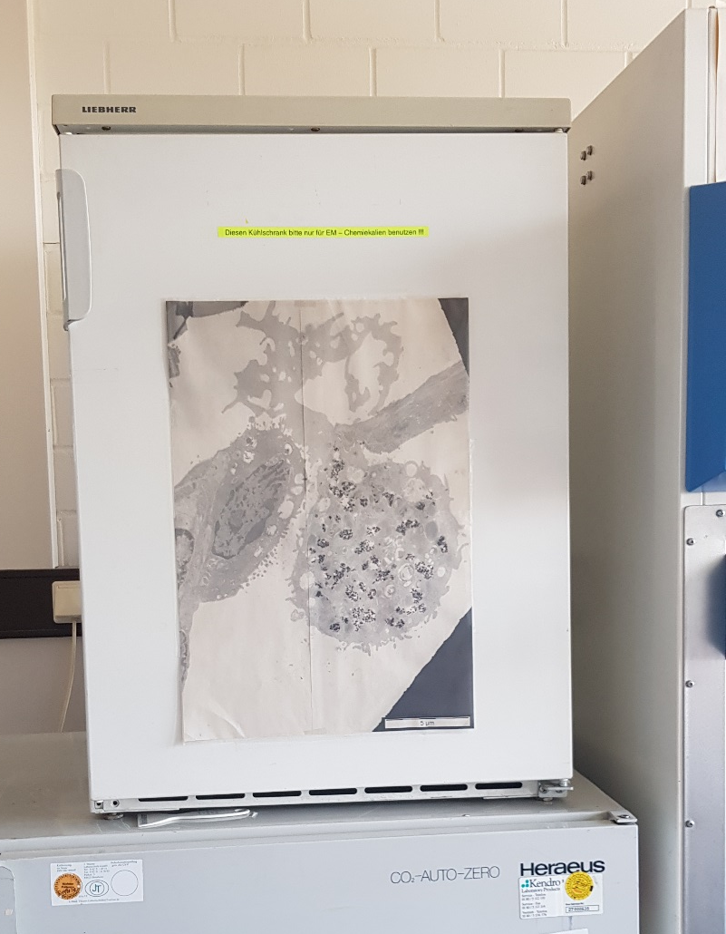
Room 511
4°C fridge: no display for temperature: open the fridge and feel if the cooling works, in case of alarm, the content must be moved to another cooling device

Slide 4
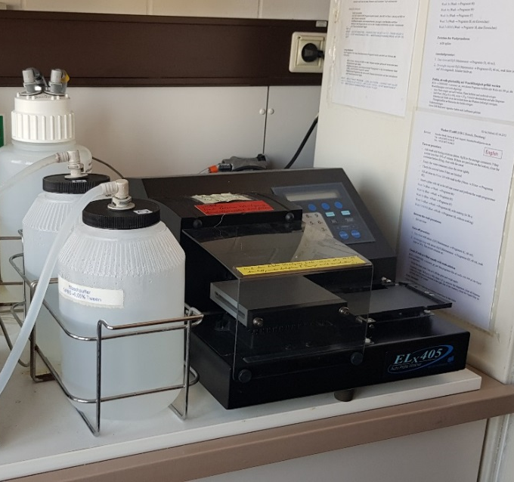
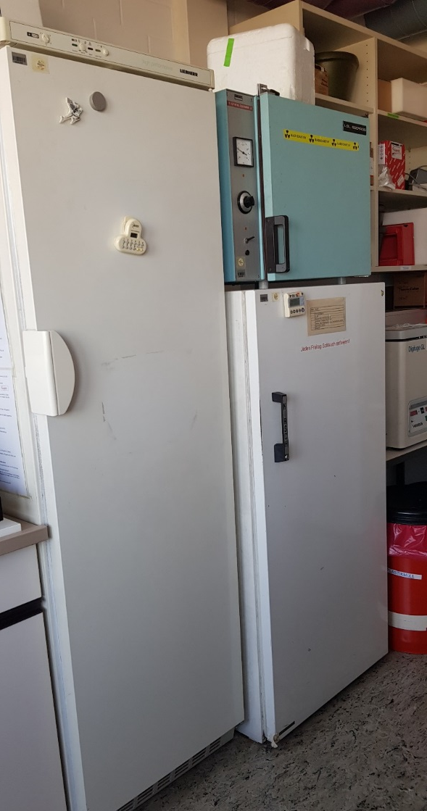
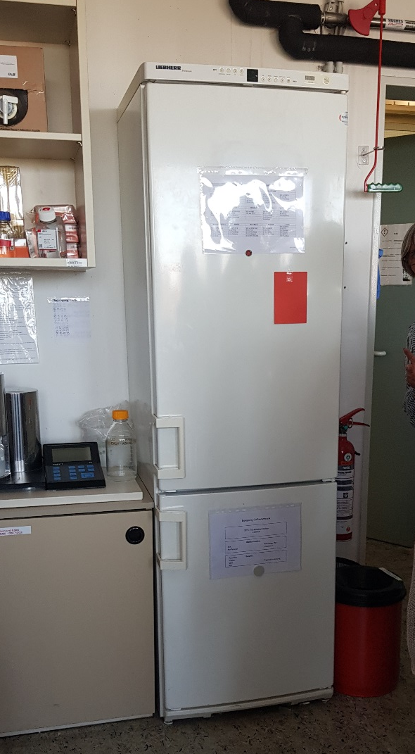
Room 510
2
1
4
3
Washer: wird ausgeschaltet
Freezer: check temperature
Fridge: check temperature
Fridge: no display for temperature: open the fridge and feel if the cooling works
Combi: check temperature
For all: in case of alarm, the content must be moved to another cooling device, e.g. in 021

Slide 5
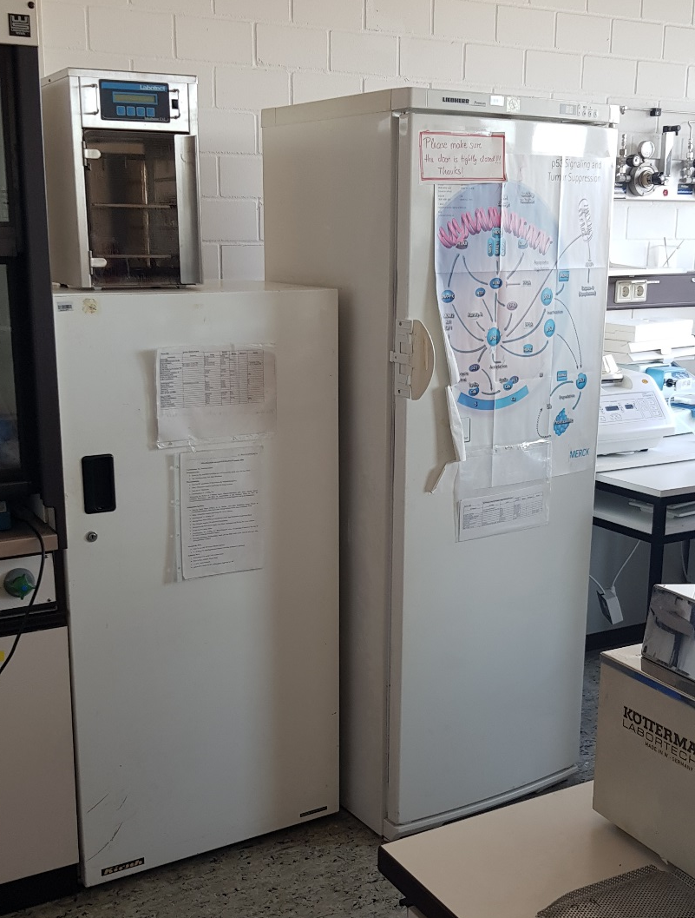
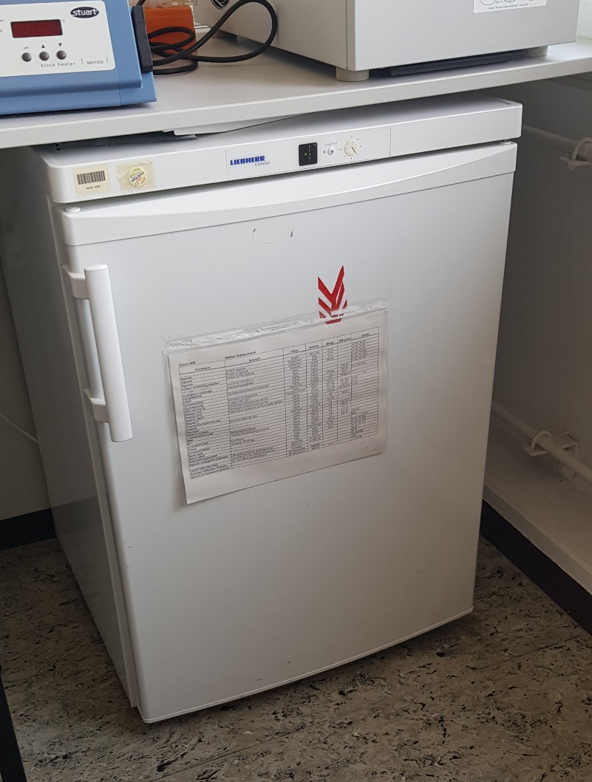
Room 509
1
2
3
Fridge: no display for temperature: open the fridge and feel if the cooling works
Freezer: check temperature
Fridge: check temperature
For all: in case of alarm, the content must be moved to another cooling device, e.g. in 021

Slide 6
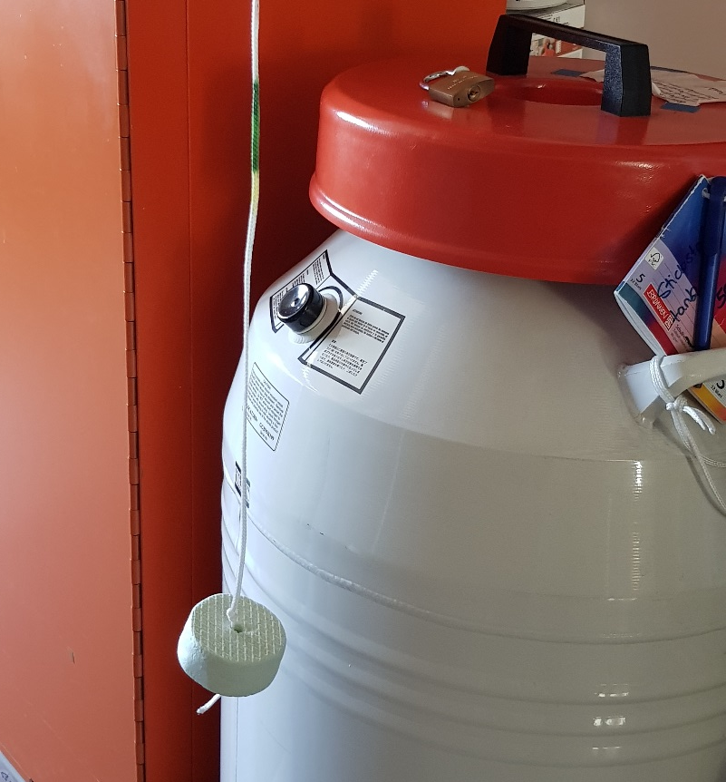
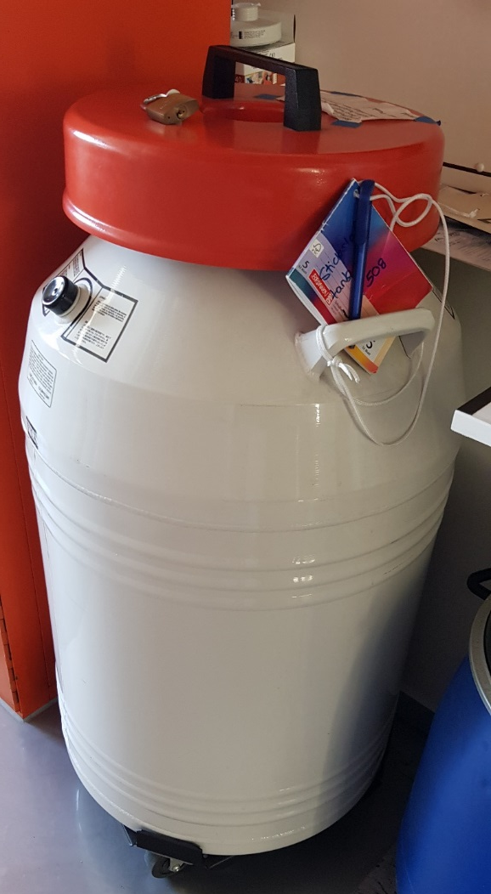
Room 508
To check the filling level, the tank has to be opened and the styrofoam has to be dipped in, only by authorized colleagues
N₂ tank: filling only by authorized colleagues

Slide 7
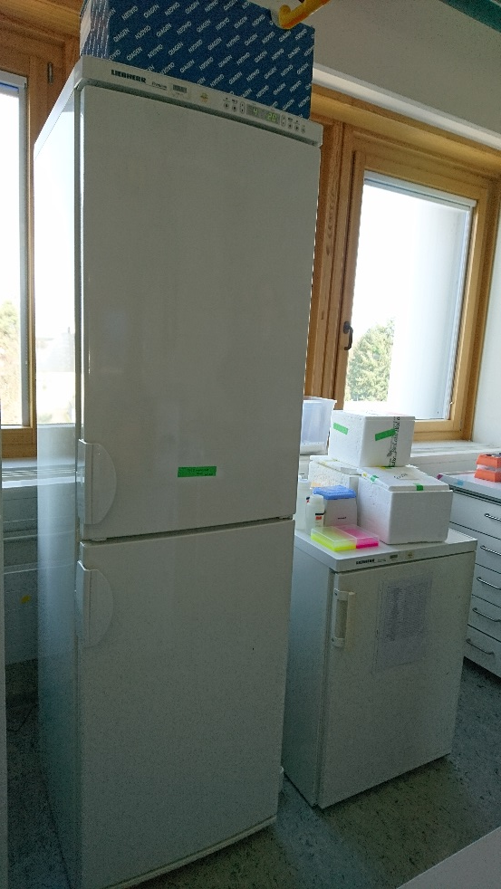
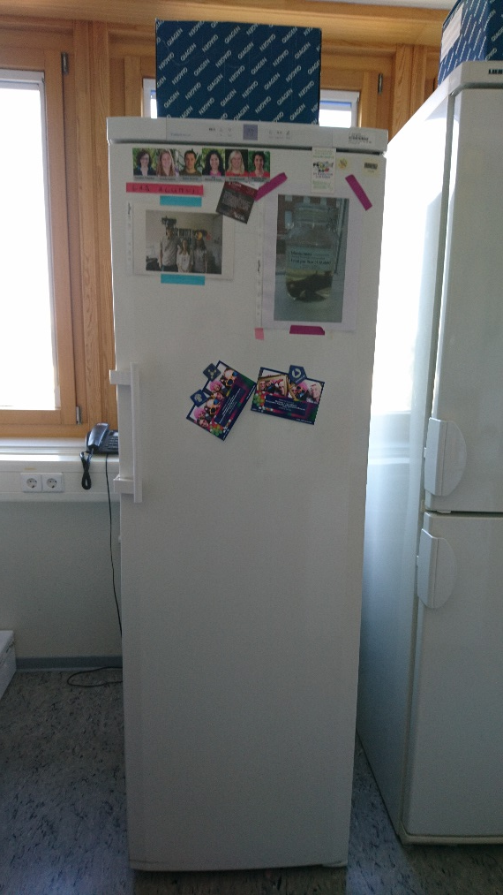
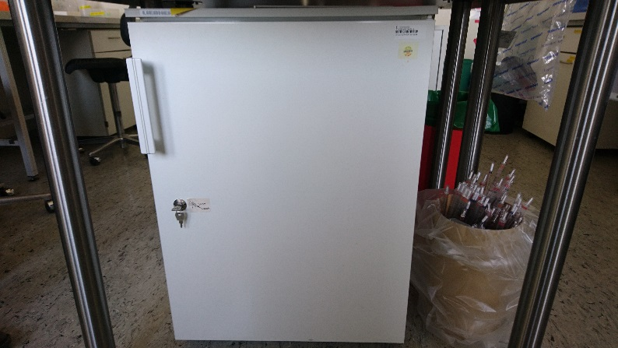
Room 447
Check temperature on display
2 Fridge
Check if still runining
This fridge 4°C is under table in center
Freezer -20°C
Combi 4°C/-20°C
and fridge 4°C

Slide 8
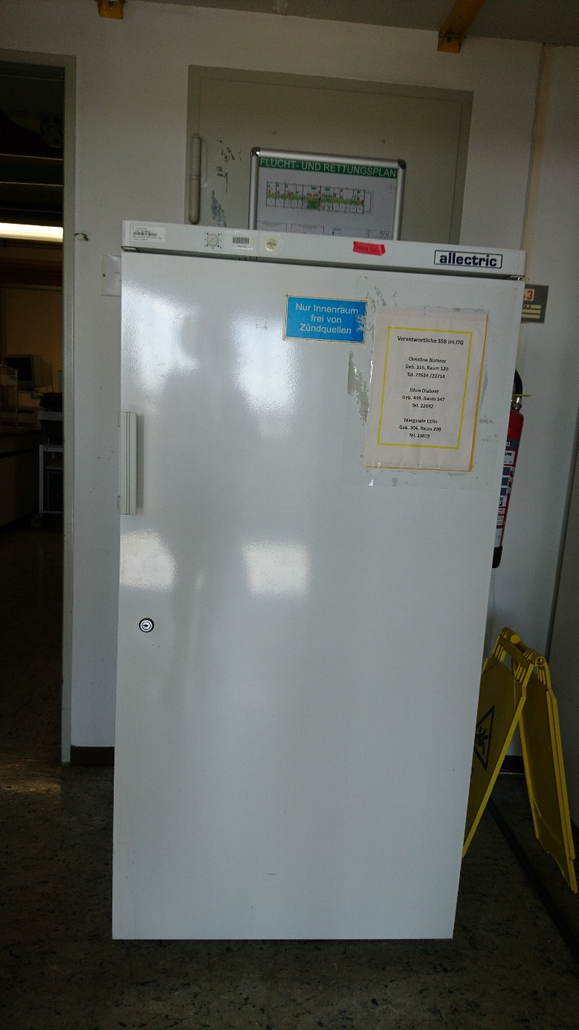
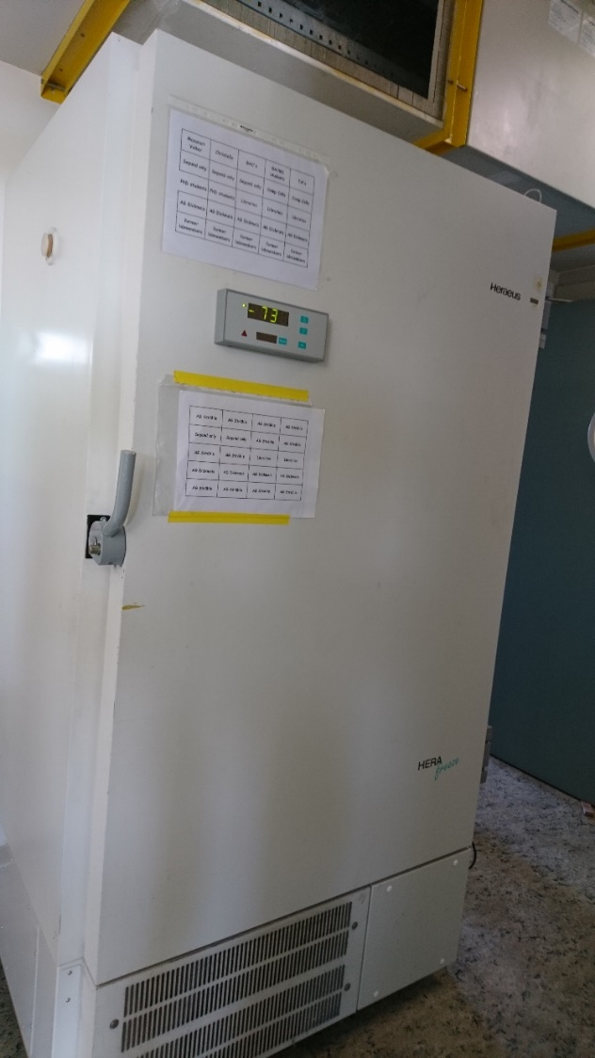
Floor 4th floor (near main entrance)
Fridge 4°C
Freezer -80 °C
Check if
still running
Check
temperature
In case of alarm, the content must be moved to another cooling device, e.g. in 021

Slide 9
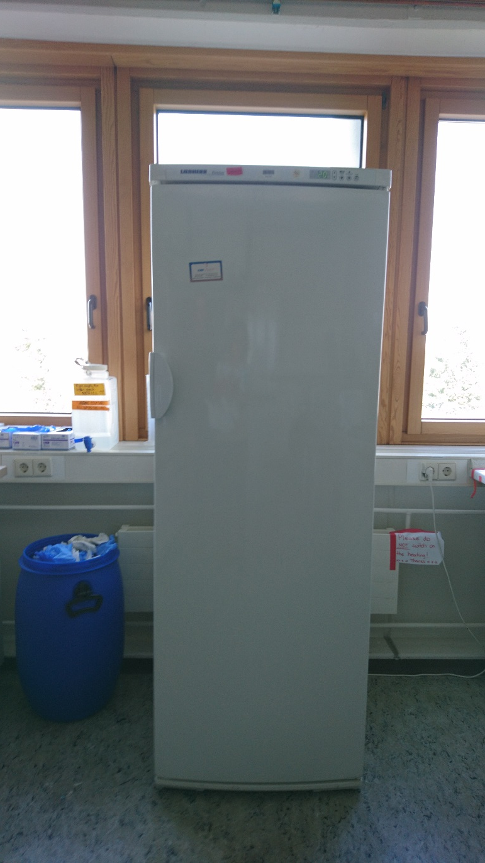
Room 416 (gel room)
Freezer -20 °C
Check
temperature
For all: in case of alarm, the content must be moved to another cooling device, e.g. in 021

Slide 10
Cellar (end of corridor left from entrance)
Freezer -80 °C
Check
temperature

Slide 11
Floor 4th floor (near main entrance)
Fridge 4°C
Check if
still running

Slide 12
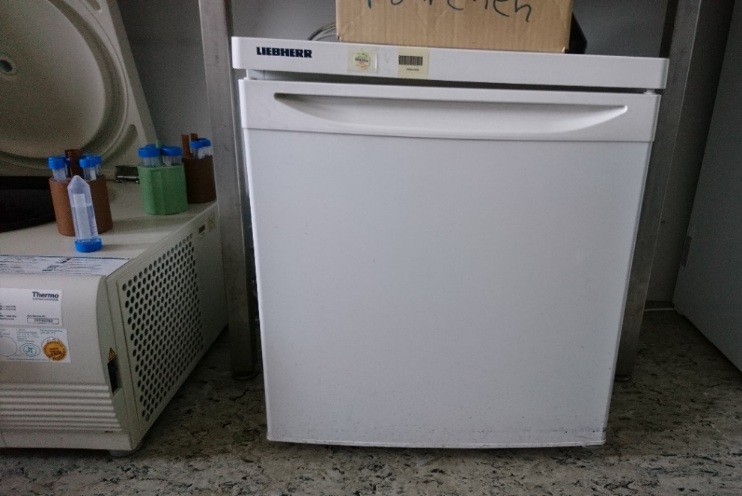
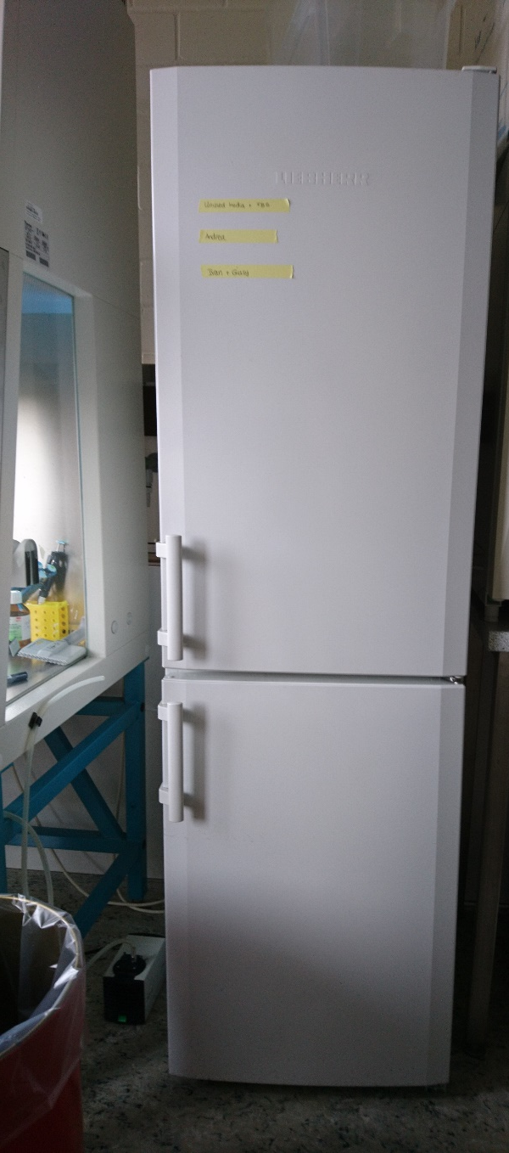
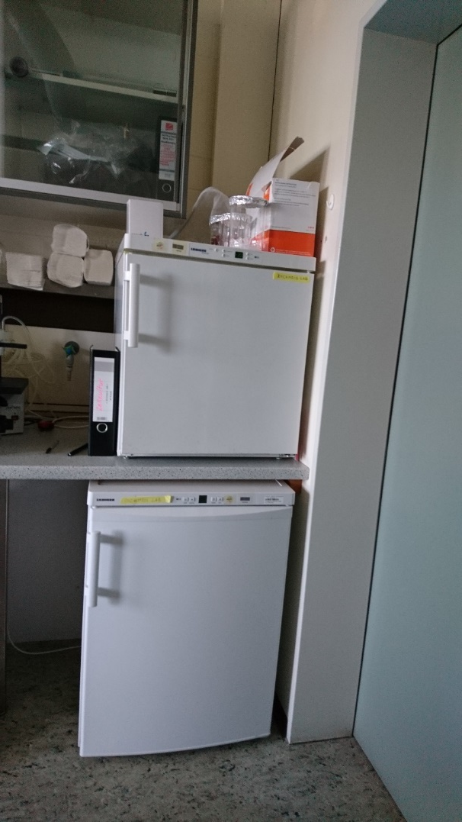
Combi 4°C/-20°C
Check if still running
Room 415 (cell culture)
2 Freezer -20 °C
Check
temperature
Fridge 4°C(under table with microscope)
Check if still running
For all: in case of alarm, the content must be moved to another cooling device, e.g. in 021

Slide 13
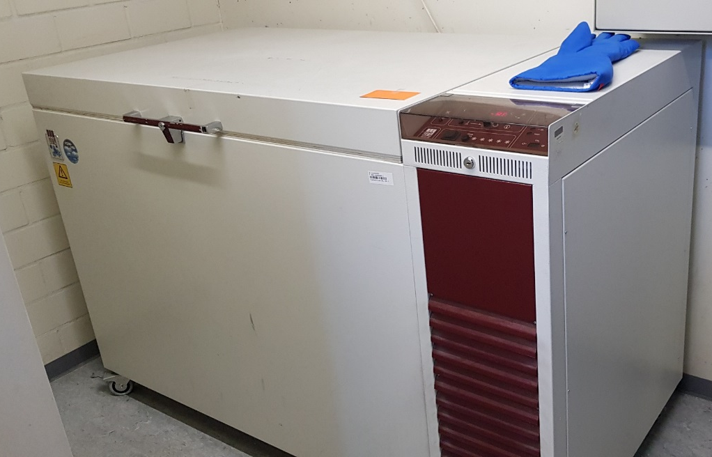
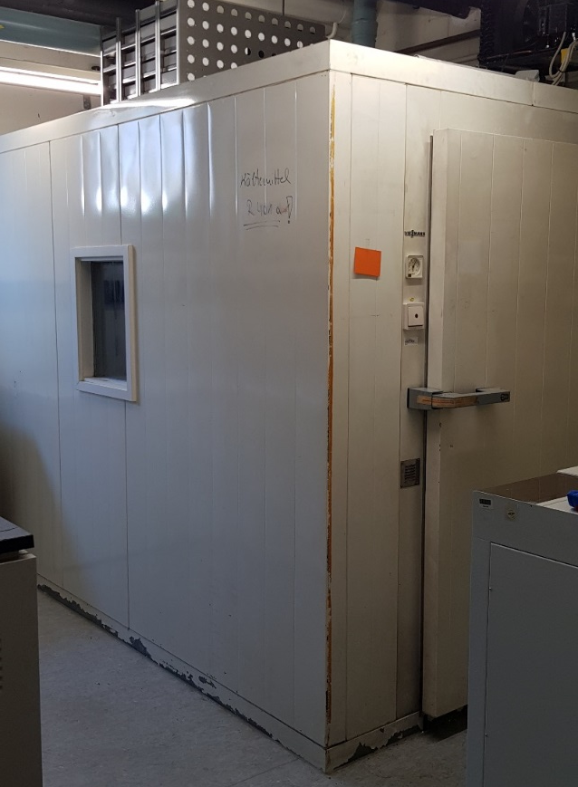
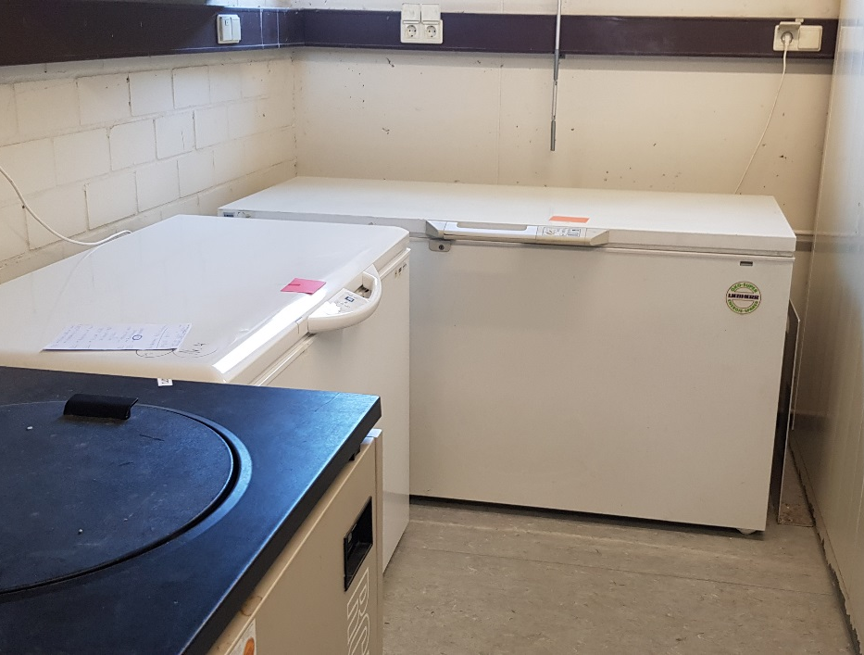
Basement, room 021
-80° freezer: check temperature
4°C cooling room: check temperature
1
2
-20° freezers: both are turned on 1. empty, serves as a reserve
2. Half filled

Slide 14
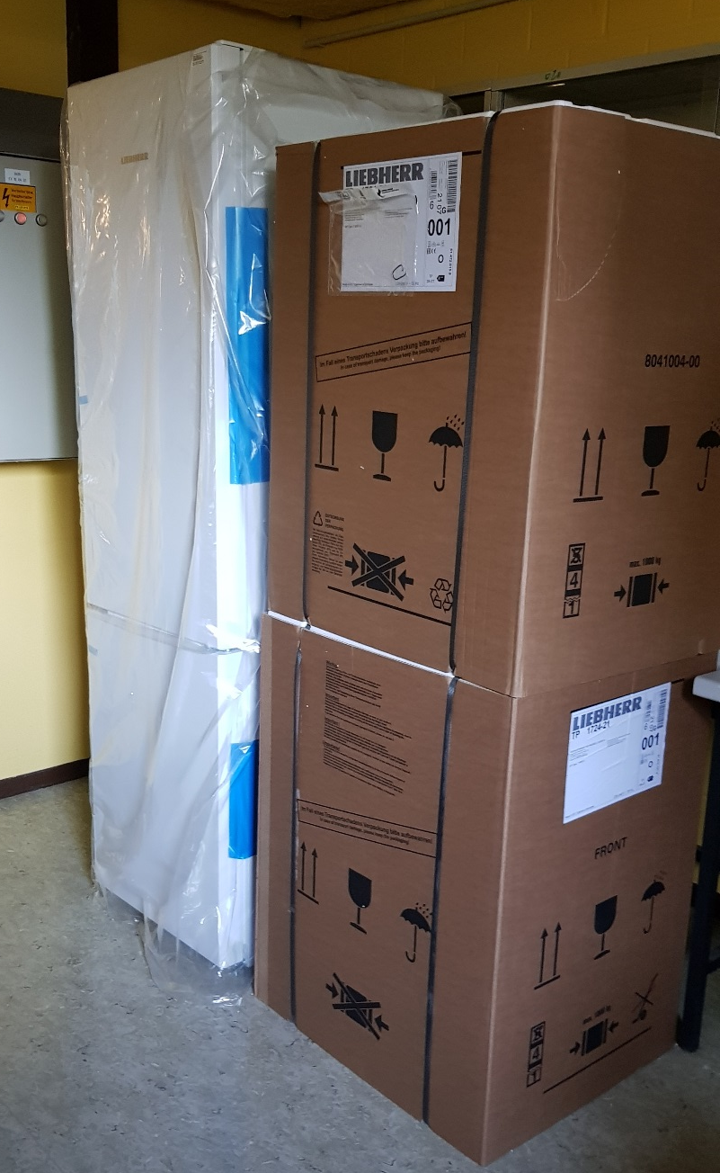
Basement, room 020
New fridges for reserve

